Slide 1
<School Logo>
June 30, 2022
Windermere Elementary School

Slide 2
Located in the beautiful East Kootenay hamlet of Windermere, BC, Windermere ElementarySchool (WES) is a part of School District #6 – Rocky Mountain. WES functions day to day in conjunction with our School Pillars. This makes WES a safe and organized place to learn for ALL students of ALL backgrounds:
At Windermere Elementary School:
We take care of others
We take care of ourselves
We take care of this place
WES is a K-7 school and with that there comes a lot of advantages. Students learn to grow within the school and the community over a long period of time. Relationships are strongly built and longstanding. We know our students well at WES because we operate and treat our students like a family. With strong links to our community stakeholders and beautiful Lake Windermere only minutes away, the rural setting of our school makes it a connected and exceptional place to learn.
Due to the size of our school, many of our classes are combined. WES staff has embraced this ongoing arrangement as an excellent means to provide diversified education to our students. At WES, we meet students where they are at educationally, socially, and emotionally regardless of their grade.

Slide 3
1 Principal
10 Teachers
4 Educational Assistants
5 Support Staff
152 in class
4 homeschool
K-7

Slide 4
Respect We foster respectful relationships that build trust, safety and well-being
Equity We strive to build learning environments that are equitable, honor diversity and inclusion, are safe, caring and healthy places to work and learn.
well-being.
Integrity We nurture a sense of self-awareness, responsibility and honesty to become environmental stewards and morally upright global citizens.
Accountability We are accountable for ourselves, our students and our communities for professionalism, transparency and quality results.
Innovation We create learning opportunities that are high quality, place-based, creative, and that encourage students to reach their full potential.
We collaborate in the pursuit of each student’s success as caring, resilient members of a global community.
Opportunity, equity, and success for all learners

Slide 5
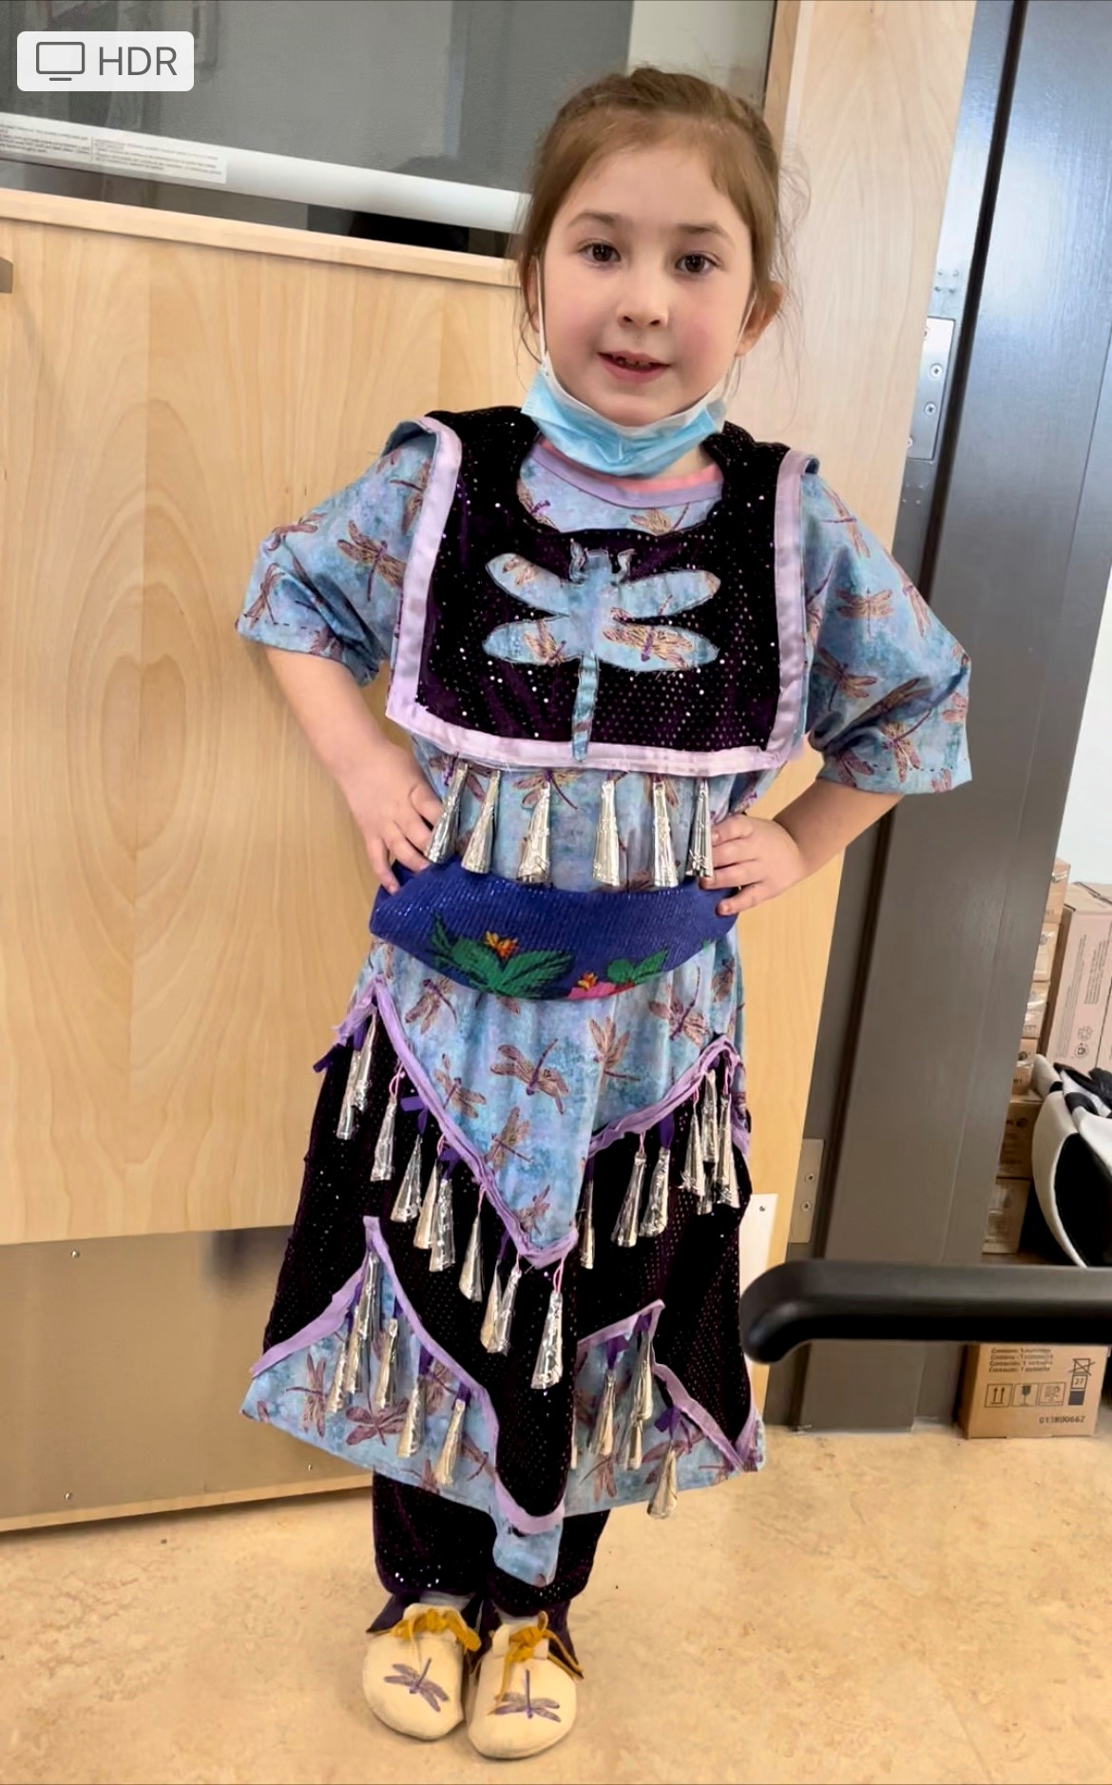
EQUITY AND INCLUSION
<Insert Image>
Increase students’ sense of belonging at school

Slide 6
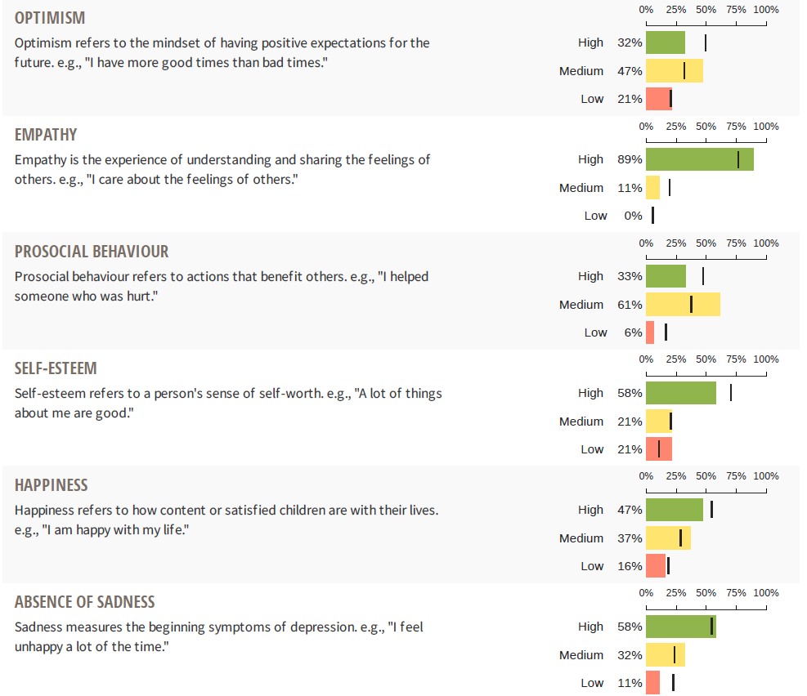
Data shows that WES students are not reporting high levels of self-esteem, and happiness as other students in the district.
Legend
Black line – district responses
Green Yellow Red bars – WES student responses

Slide 7
In previous survey data staff noted students at WES feel less optimistic and report lower self esteem and sense of belonging. This means we need to focus on connectedness and belonging at our school.
Belonging and Connectedness
To what extent will the implementation of weekly classroom Community Circle structures increase students’ feelings of belonging and value at school.

Slide 8
*All staff review Inquiry evidence monthly
*Student questionnaire (Oct/May) - ‘I feel like I am important to the school’ ‘I have at least 1 adult who cares about me
*Examine MDI and SLS data in spring 2023
100% of students will respond ‘Agree’ to the 2 survey questions in May 2023
*Student survey Oct/May
*MDI/SLS – Feb
*Monthly review of classroom data (circle practice)
*Student mental health supports (school based and district)
*Resources for Community Circle practice
-School based team
-Referrals to Morning Check in
-TLC staff check ins
-Circle Practice

Slide 9
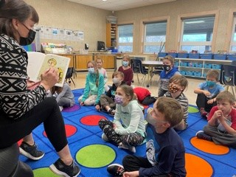
SUCCESS FOR ALL LEARNERS
<Insert Image>
Literacy – Increase all students’ reading achievement

Slide 10
The trend for the past few years at WES is that approximately 50% of our students are not meeting grade level expectations (scoring only a 1 or 2) in reading by the end of the school year.
How will monthly examination of assessment data, combined with quality instruction and progress monitoring of student reading data, improve student reading skills?
Students will learn strategies for how to improve their reading in decoding/fluency and comprehension

Slide 11
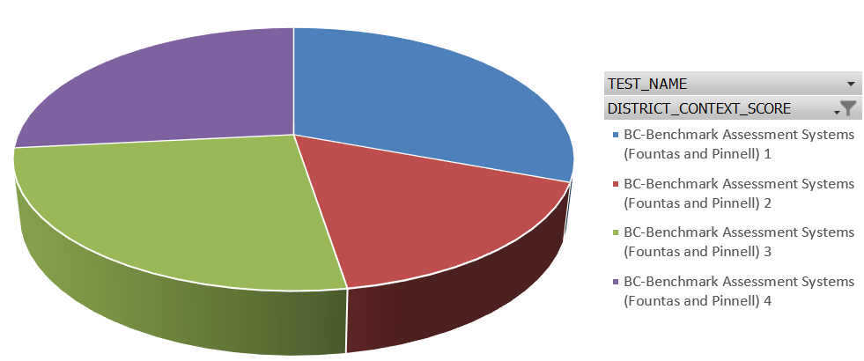
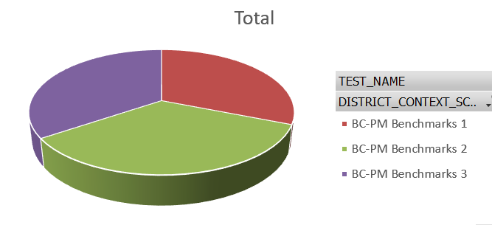
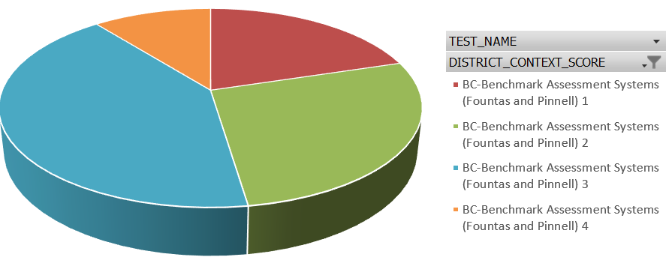
Fall 2021 PM Benchmark gr 1-3 Fall 2021 Fountas & Pinnell gr 1-3 gr 4-7
Spring 2022 PM Benchmark Spring 2022 Fountas and Pinnell

Slide 12
100% of students will show growth in reading (PM/F&P, class observation and assessments)
Resource - Shifting the Balance
Science of Reading – 5 Pillars
Progress monitoring – using data to make timely instructional decisions
Use of resources such as Education Assistants
Monthly review of student reading data (progress monitoring) for Tier 2/3 students)
*School Based Team
*SeeSaw (digital portfolios)
*Instructional Rounds
*Staff colleague observation opportunities
Staff will review reading benchmarks of Tier 2/3 students monthly and plan for instructional interventions

Slide 13
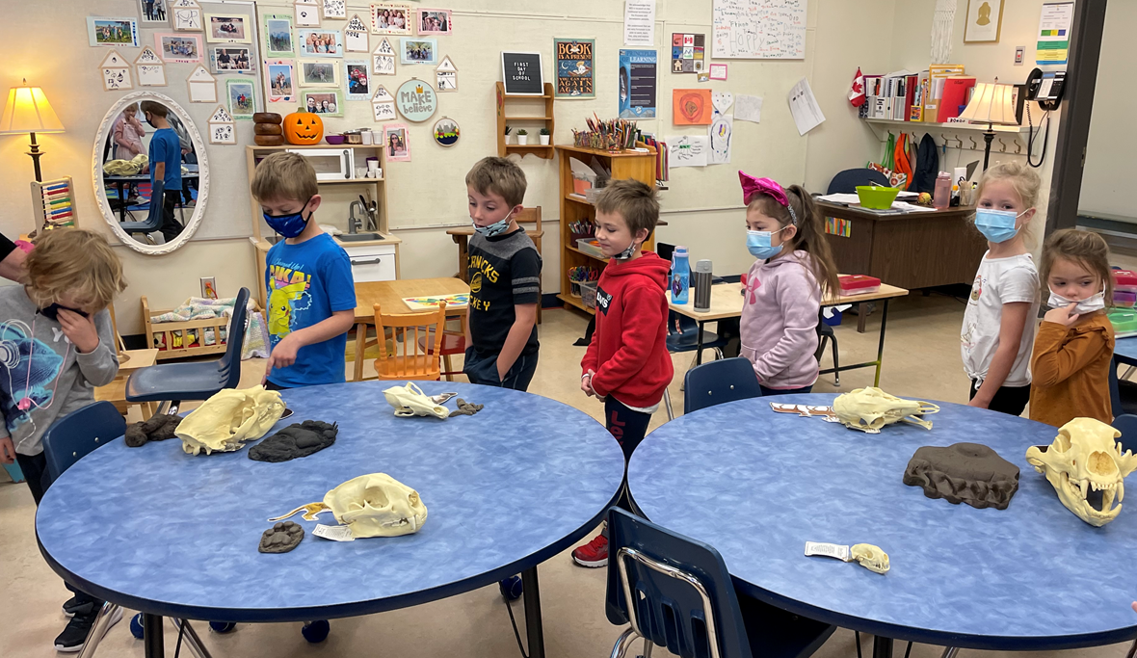
SUCCESS FOR ALL LEARNERS
<Insert Image>
Numeracy - Increase student achievement in numeracy.

Slide 14
To what extent will students demonstrate the ability to communicate math thinking in many ways if all teachers follow a daily routine of How Many Ways
Teachers notice that students are sticking with simplistic, basic equations and math thinking. Teachers wish to stretch students thinking so that they can communicate math thinking in many different ways.
Though we see our students make gains from Fall to Spring in SNAP data, we still have 23% of students who are not meeting grade level expectations by end of school year.
Communicating mathematical thinking in many ways

Slide 15
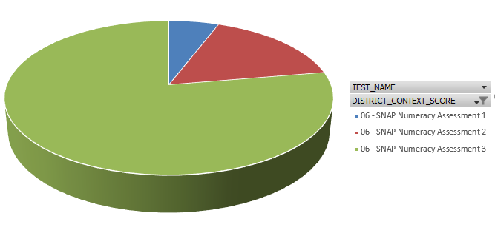
What does the data say?
SNAP 2021 Fall Data
SNAP 2022 Spring Data
Legend: Blue – 1, Red – 2, Green - 3

Slide 16
*Oct/May SNAP assessment
*monthly staff examination of numeracy artifacts from classrooms
*May Staff Learning meeting – examine data and evidence
*SNAP (Oct/May)
*Monthly staff examination of student math samples (co-assessment and idea generation for extending student mathematical thinking
All students will show growth in Spring SNAP assessment and report cards
*numeracy tasks vs math problems
*The Power of Ten
*formative Assessment
*School Based Team
*Teacher Observation opportunities
*Instructional Rounds
*Learning Meetings

Slide 17
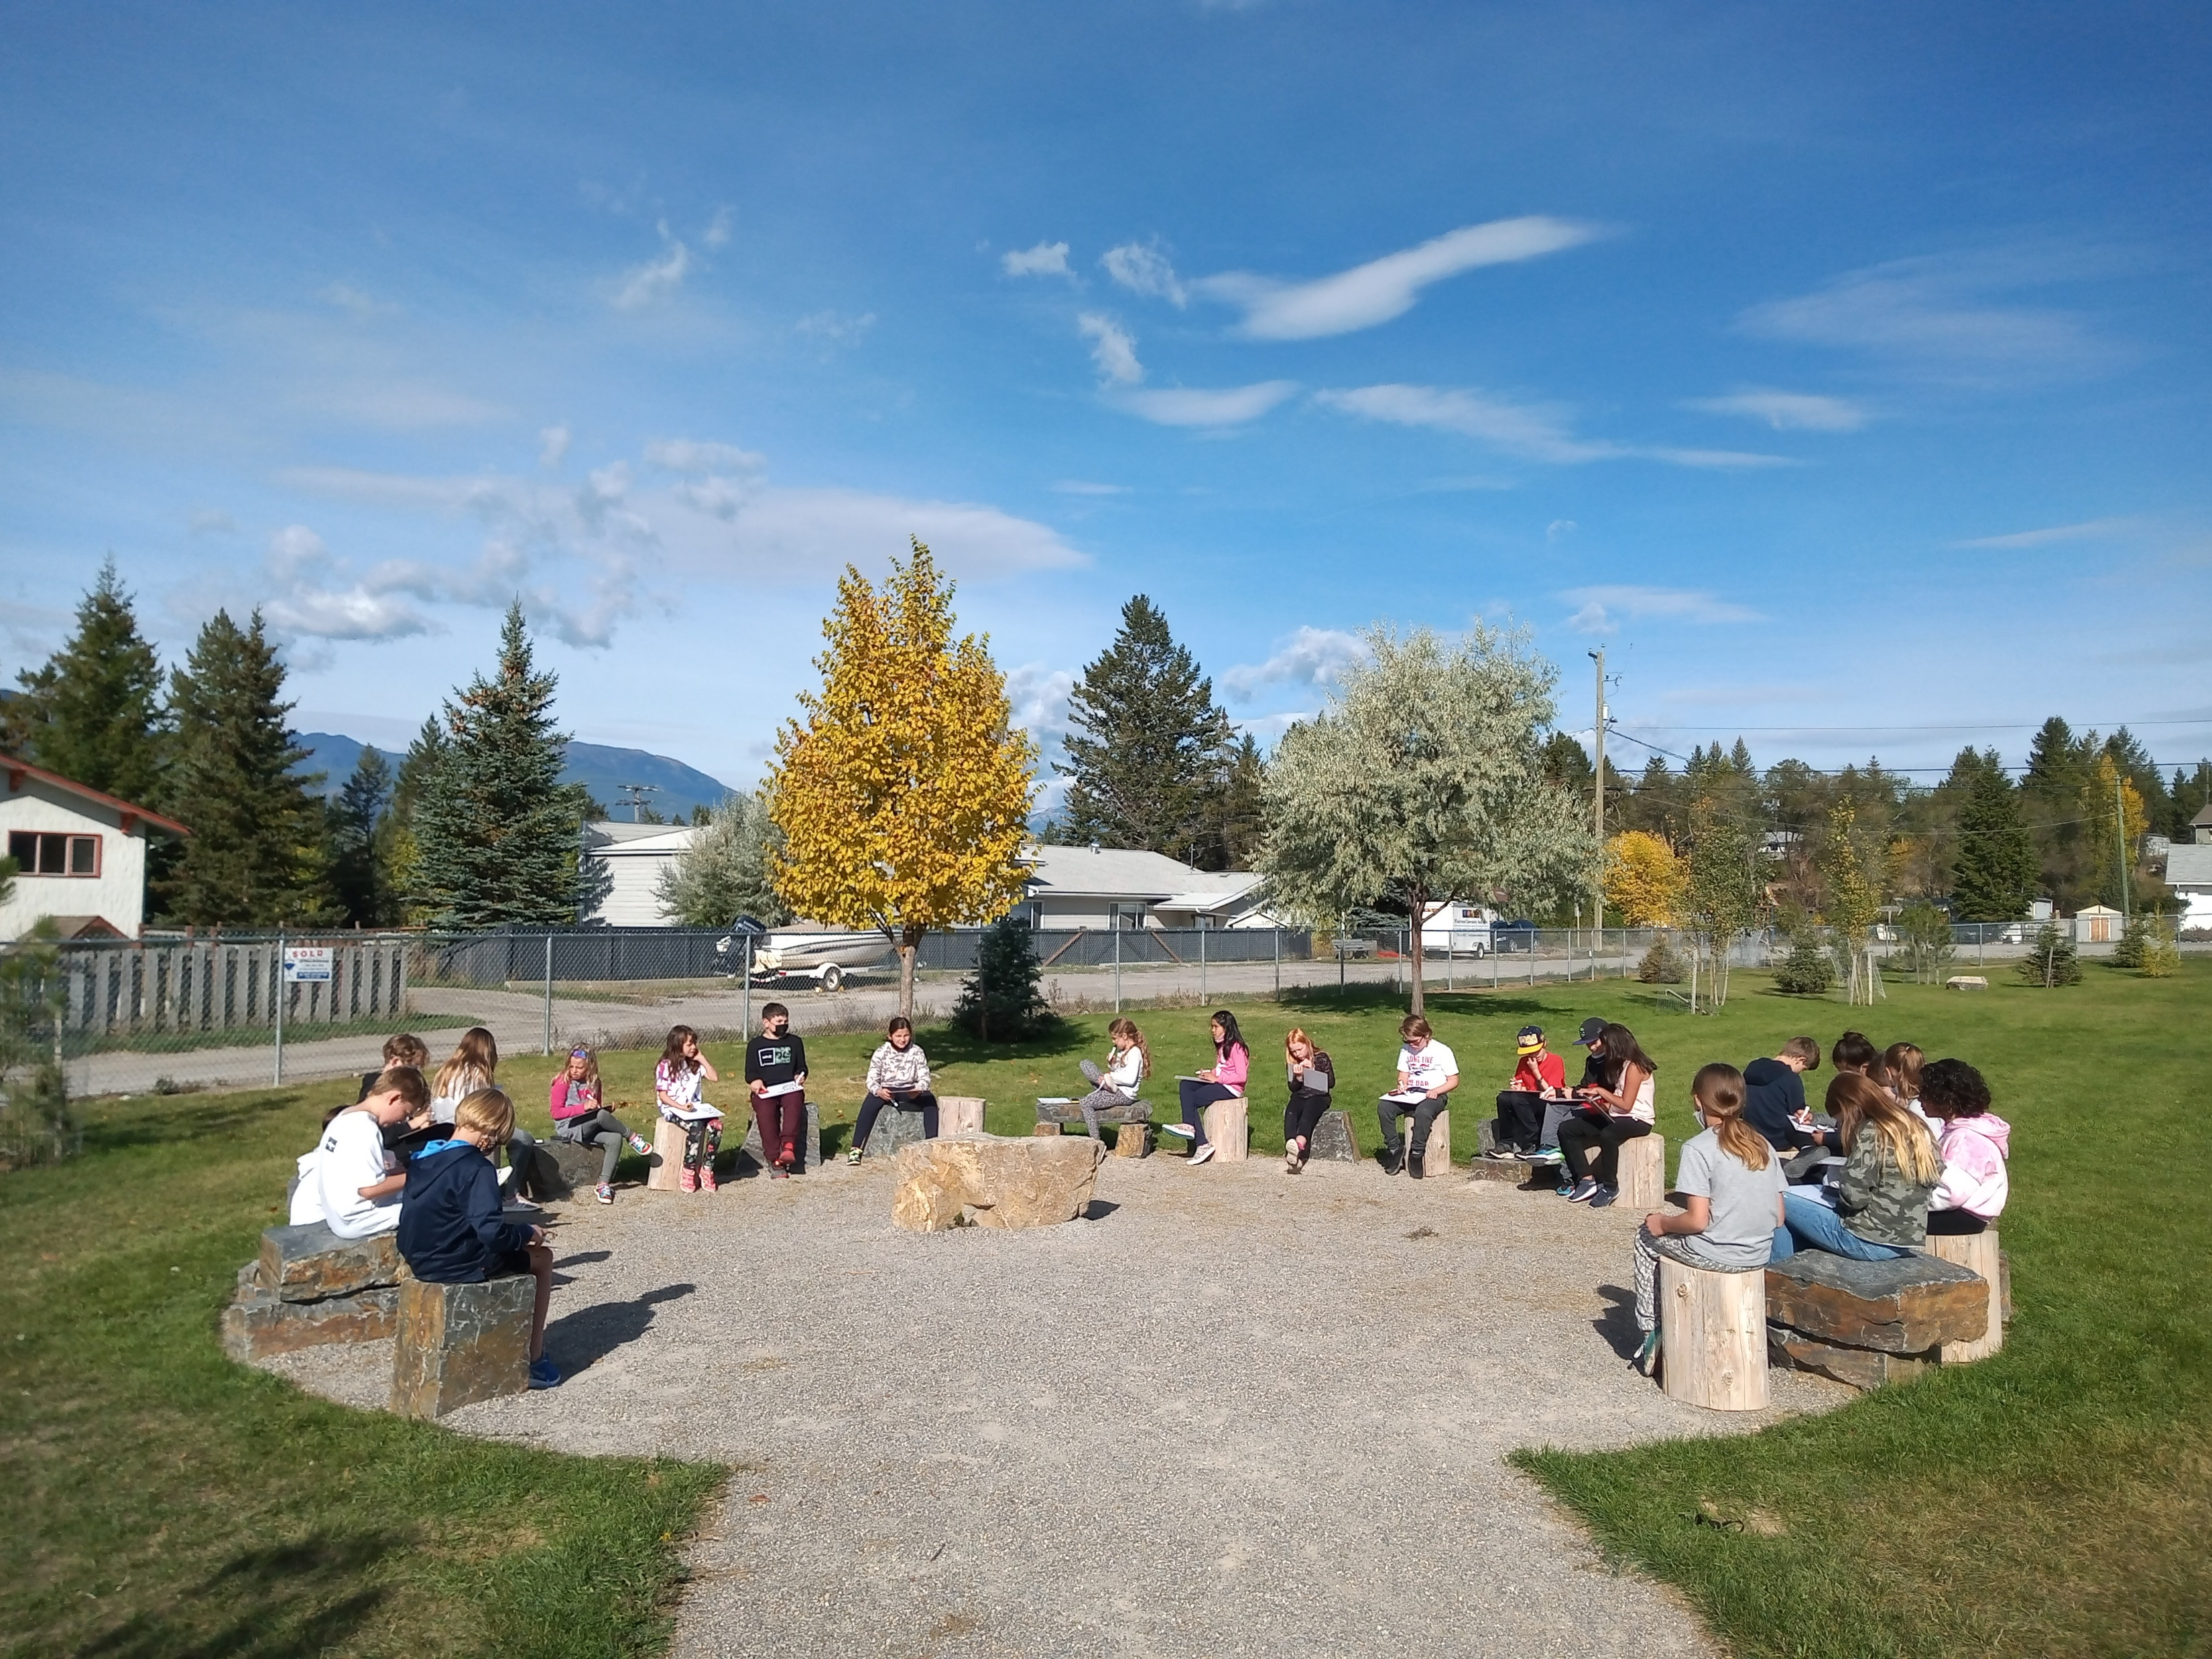
EXCELLENCE IN TEACHING AND LEADERSHIP
<Insert Image>
Improve quality and frequency of collaboration

Slide 18
There has been a decrease in collaborative opportunities for staff due to disrupted learning (covid) over the past two years. Staff report value in working together to examine student artifacts of learning and co-create learning activities that create alignment across K-7.
Previous collaboration opportunities included:
collaborative marking,
classroom observations of others teaching,
and co-planning.
The following collaborative opportunities will be increased with structure and accountability:
monthly collaborative meetings (primary and intermediate groupings) with a focus on examining student evidence from numeracy and literacy goals. (Staff commitment: 90 minute learning meeting monthly + 30 minute monthly reading meeting
Collaborative marking – co-creating aligned formative assessment practices within the school
Meaningful strategic collaboration to create a team approach to solving learning problems
To what extent will high quality collaboration be developed through all staff participating in structured monthly collaborative conversations which are centered around student data and planning for intervention with reflection and accountability measures adhered to by all staff.

Slide 19
Staff conversation and reflection at monthly learning meetings
100% of staff will report better quality and frequency of collaboration on a WES created survey. Survey administered Oct/May
*Aug ProD – co-create criteria for quality collaboration and survey questions
*Spring learning meeting
*monthly scheduled collaborative learning meetings
*Instructional Rounds
*Collaboration vs observation
*Aligned formative assessment practices, *Using data to make changes to instruction
*Instructional Rounds
*Learning Meetings
*Collaborative assessment time
*Meeting norms and staff accountability measures

