Slide 1
2022-2023
Selkirk Secondary School

Slide 2
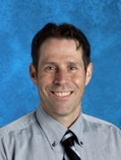
At Selkirk Secondary School, data is reviewed on an ongoing basis including at weekly Vulnerable Student Team and School-based Team meetings, monthly Staff and Department meetings,and through our School Planning process each Spring. Additionally, report card, work habit, and attendance data are reviewed quarterly. This Cycle of Review allowed us
to identify areas of strength as well as areas that require additional focus and supports, which in turn helped guide the goals in our School Plan for Student Success for 2022-2023.
As a staff, we continue to notice an increase in the number of students with mental health challenges and with chronic absenteeism as well as an achievement gap for students with a Behavioural Designation leading to our Strategic Priority One - Equity and Inclusion with a goal of identifying, tracking, and supporting our most vulnerable learners through the Child At-Risk in Education (CARE) team and staff mentors.
For Strategic Priority Two- Success for All Learners, we also identified the need for a literacy and numeracy goal that supports task analysis skills, developing student’s ability to critically analyze and work through problems in a logical manner.
For Priority Three- Excellence in Teaching and Leadership, our goal is focussed on professional learning discussions and growth through structured collaborative and observation time including Instructional Rounds.
Within our plan, we will demonstrate how current data and collaboration with our staff has provided the evidence to
support our strategic goals for next year.
~ Clint Dolgopol

Slide 3
57
3 - Admin
23 - Support Staff
31 - Teachers
540 – SSS
90– Indigenous
30 - International
8-12
90 - Graduating
2023

Slide 4
Every student and staff member at Selkirk will benefit from being part of an open-minded and innovative learning community built upon the pillars of respect, growth, and equity.
Safety
behave in a kind manner towards each other
Team
create positive relationships and engage actively
Organized
communicate, arrive on time and prepared
Respectful
mature, diverse thinking and considerate
Mindful
encourage, ethical decisions and engage

Slide 5
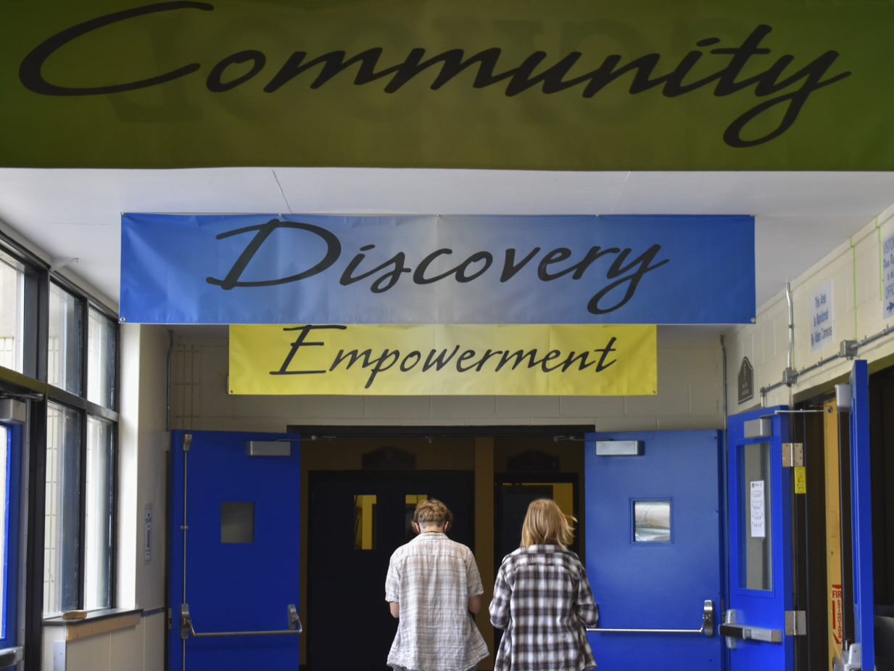
Equity and Inclusion
To increase the social/emotional well-being of our students.

Slide 6
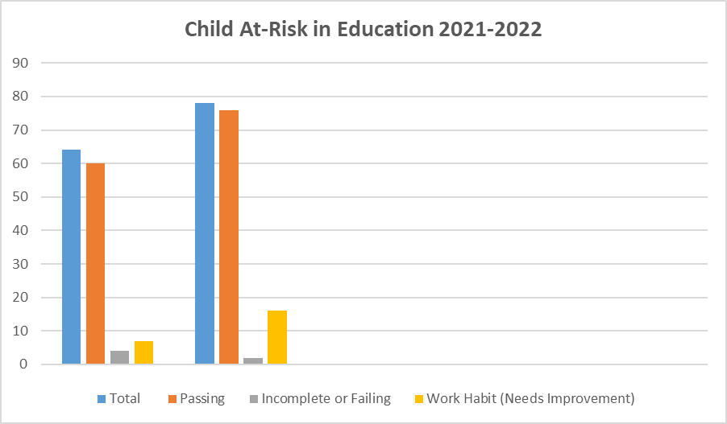
 | Is the school a place where you feel like you belong? Most times or always
Grade 9 | 48%
Grade 10 | 49%
Grade 11 | 51%
Grade 12 | 62%
Q2
Q3
**The number of students monitored through our CARE team and staff mentors decreases as they transition from grade to grade.

Slide 7
During School-based and Vulnerable Learning Team weekly meetings, monthly staff meetings and department meetings, we have created an ongoing cycle of review to improve student achievement. We use the following evidence to identify our most vulnerable students and create a vulnerable student list. Based on the Student Learning Survey results indicate a concern in belonging and connectedness.
Additionally, we continue to notice an increase in anxiety and mental health concerns amongst our students. As a result, we will focus on increased belonging and will continue to identify, track, and support our most vulnerable learners through our CARE team and staff mentors.
We will increase belonging and connectedness amongst all students.
Our specific inquiry will focus on the continued success of a CARE Team and staff mentors with the goal of increasing connections with staff and each students’ sense of belonging.
To what extent will the implementation of the CARE program, STORM Time and other school initiatives increase belonging of our students?

Slide 8
Spirit Work
Four Seasons of Reconciliation
Trauma-Informed Practices- Chuck Geddes
Social-emotional Learning
Weekly Vulnerable Learning Team meetings, School-based Team, and Learning Services meetings
Gr. 8 Transition Passport Program
All staff review quarterly
To increase belonging for all students by 10 %
Monthly staff meetings

Slide 9
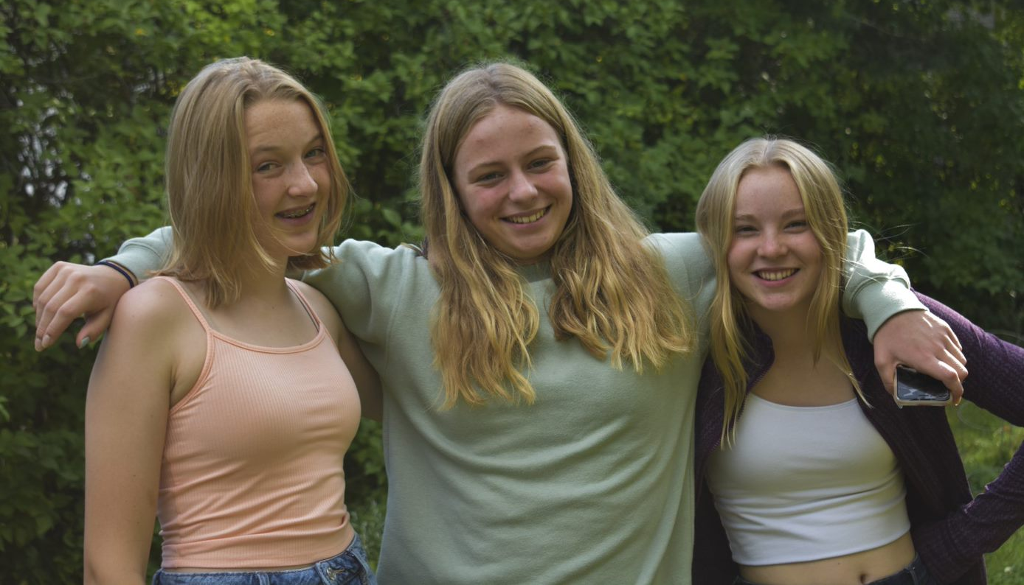
Success for all learners
Growth in Numeracy and Literacy
To increase student achievement in numeracy and literacy

Slide 10
Growth in Numeracy and Literacy
A large percentage of our students are achieving proficient to extending scores in their Language Arts and Math classes. However, while we are noticing an increase in students achieving the levels above on the provincial graduation assessments, we continue to see bridge the gap in comparison to report card scores. Specifically, when reviewing assessment results, we noticed a need to focus on task analysis and thinking skills.
We will use thinking strategies across the curriculums to focus on tasks that incorporate numeracy and literacy skills while aligning with the provincial graduation assessments.
To what extent will ongoing thinking challenges lead to an increase in student achievement in numeracy and literacy?

Slide 11
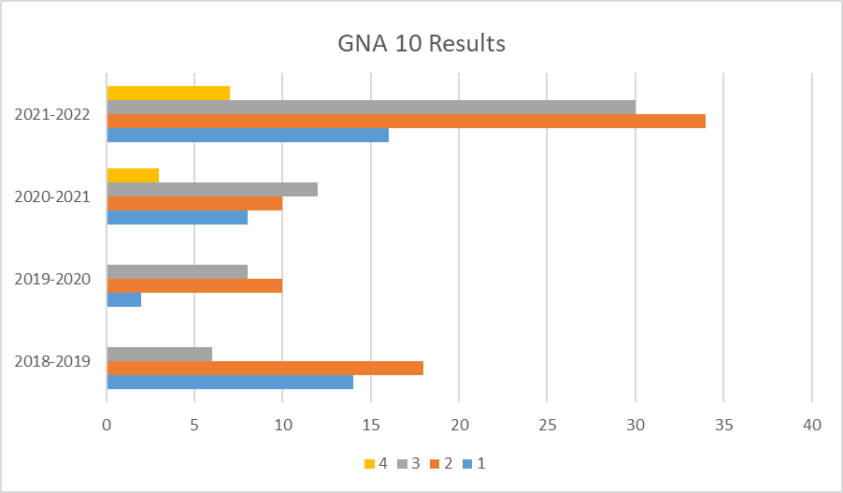
Graduation Numeracy 10 Assessment

Slide 12
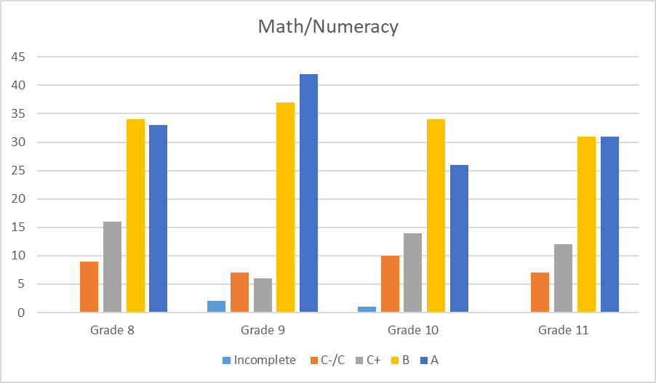
Report Card Scores in Math
Data

Slide 13
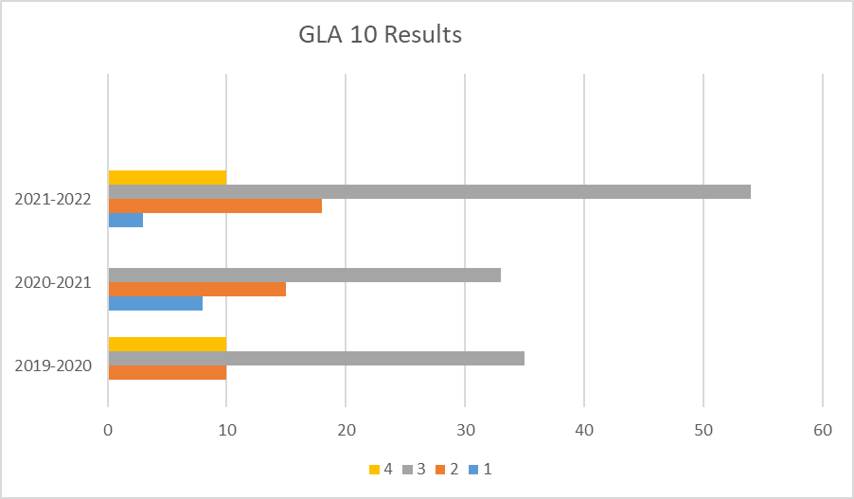
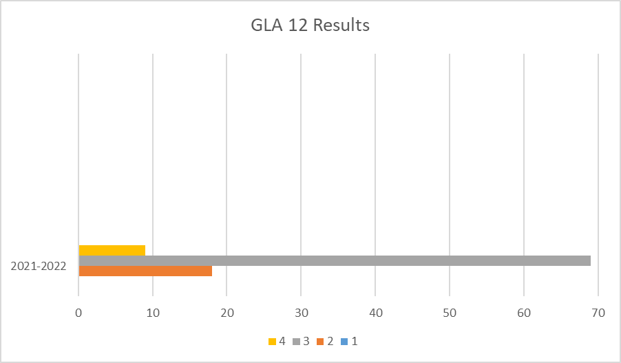
Canadian Achievement Test 4 (CAT4)
District Wide Write 8 (DWW)
Foundations and Skills Assessment 7 (FSA)
Graduation Literacy Assessment 10 and 12
Report Card Data
Graduation Literacy 10/12 Assessment

Slide 14
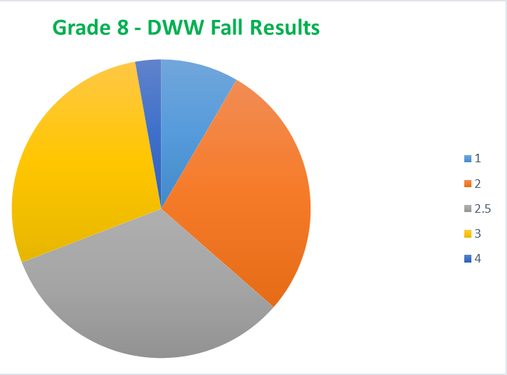
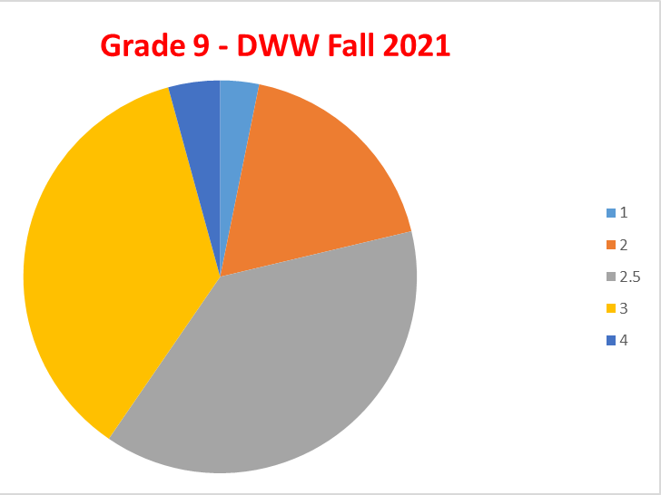
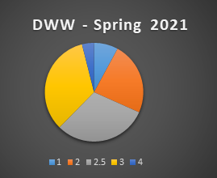
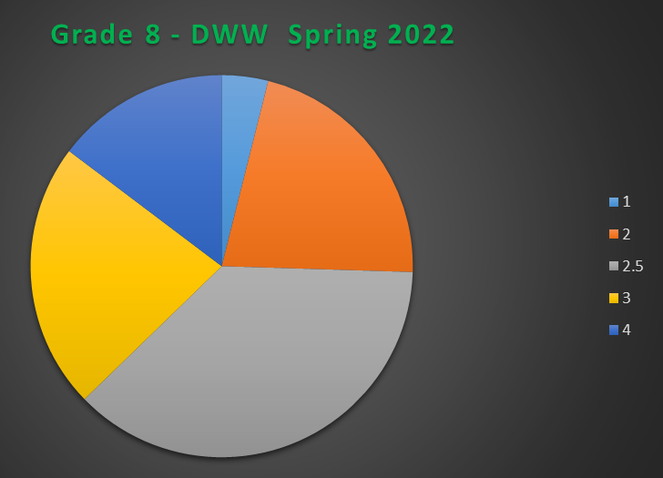
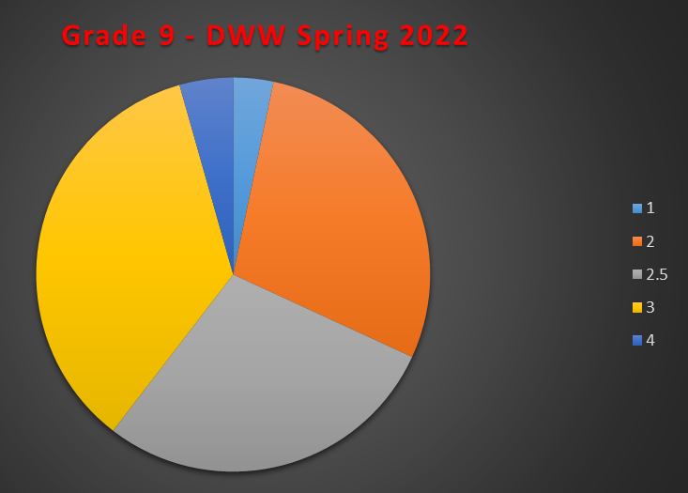

Slide 15
Numeracy
Grade 8 Numeracy Assessment
Graduation 9 Numeracy Assessment
Graduation Numeracy Assessment 10
Report cards
60% Proficient
to Extending on the GNA 10
September, January, and June Staff Meetings
Collaborative time-
create numeracy tasks
Numeracy team meetings including District VP of Numeracy
Anchor marking of junior assessments
Student samples review- all staff
Staff and Department Meetings
Collaborative time
Observation time
District Vice-Principal of Numeracy
Monthly challenges

Slide 16
Literacy
Road Maps developed by each department
October and May writes - DWW
-November and April writes for GLA
DWW/CAT4/GLA 10 and 12
Ongoing monthly
staff meetings
80% Proficient to Extending in the GLA 10 and …. for GLA 12
Shared exemplars
Anchor Marking
Department collaborative time
SBT for specific higher tier intervention
Literacy Intervention Groups
LEARNING FOCUS
Staff meeting and collaborative time to structure specific interventions
Monthly challenges

Slide 17
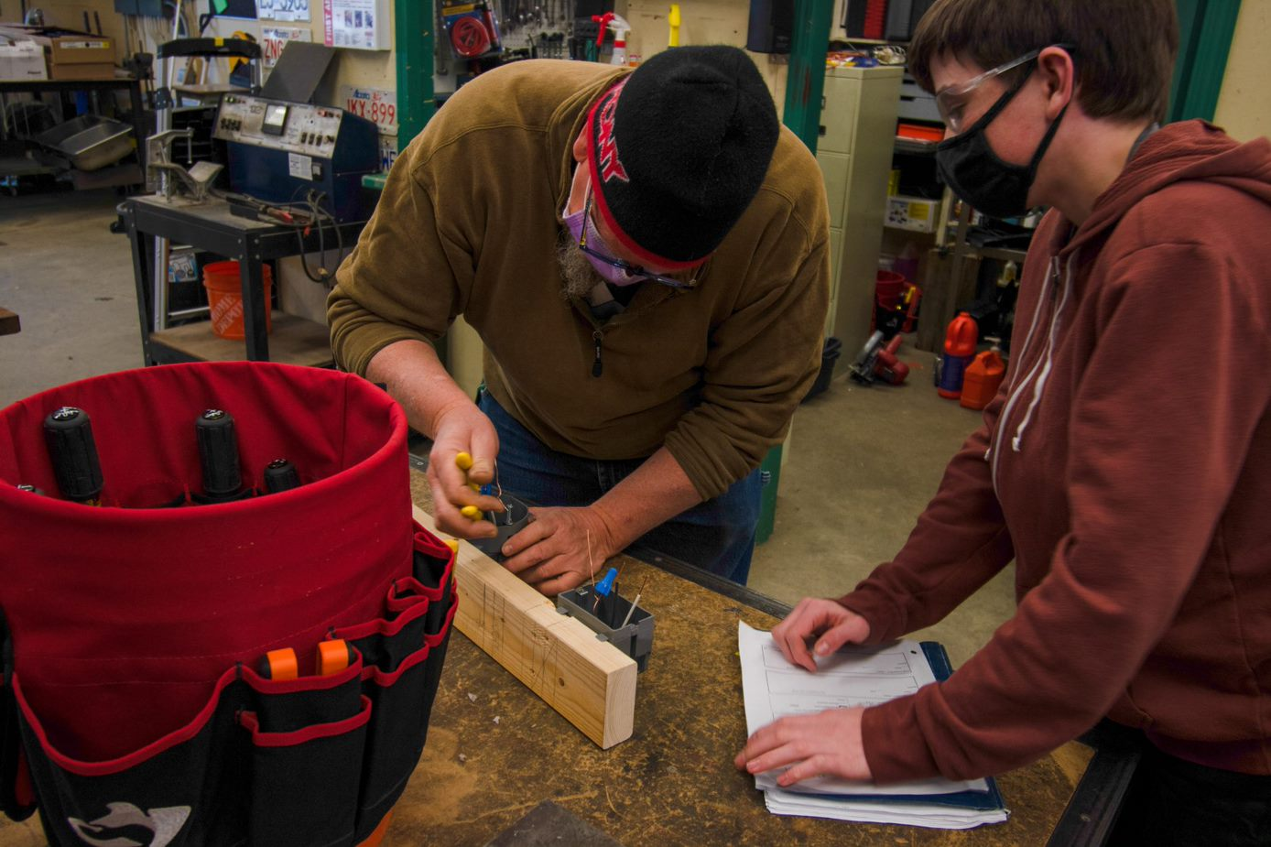
Excellence in Teaching
To increase the opportunity for meaningful collaboration for all teaching staff

Slide 18
Last school year, our department heads participated in observation protocol training through the National School Reform Faculty (NSRF). This year, teachers will use scheduled collaborative time and instructional rounds to practice the protocols from the NSRF. During our upfront Professional Development sessions, our Department Heads will demonstrate how we can utilize the protocols to develop teaching strategies and expand our practices. Staff meeting agendas will include ongoing collaborative strategies to grow and share ideas to enhance excellence in teaching.
We will use collaboration and meaningful instructional observations to enhance teaching practices.
To what extent will instructional rounds and observation strategies increase authentic collaboration and cross curricular initiatives?

Slide 19
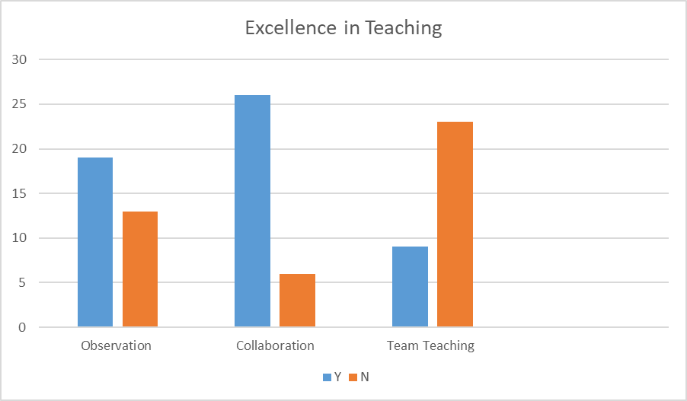
Anecdotal Results
Overall I found this observation useful to feel more confident in my instruction on annotation, and to give me direction in how to go about it. I also feel it will be beneficial to the students if there are similarities in the language used and process followed between teachers.
Amy Perry Humanities Teacher
We will continue to collaborate on projects, as our goals are far more achievable and projects more impactful when done together.
Lena McCuaig Art Teacher

Slide 20
Staff
Excellence in Teaching Survey
June review and tally of Collaborative and Observation time used
All teaching staff-
Learning Partners
Review at department meetings
Data collection
“Critical Friends”
“The Coach Approach to School Leadership"
“Instructional Rounds in Education”
Department Meetings
Staff Meetings
Structured collaborative and observation time Budget support

