Slide 1
2022-2023
David Thompson Secondary School

Slide 2
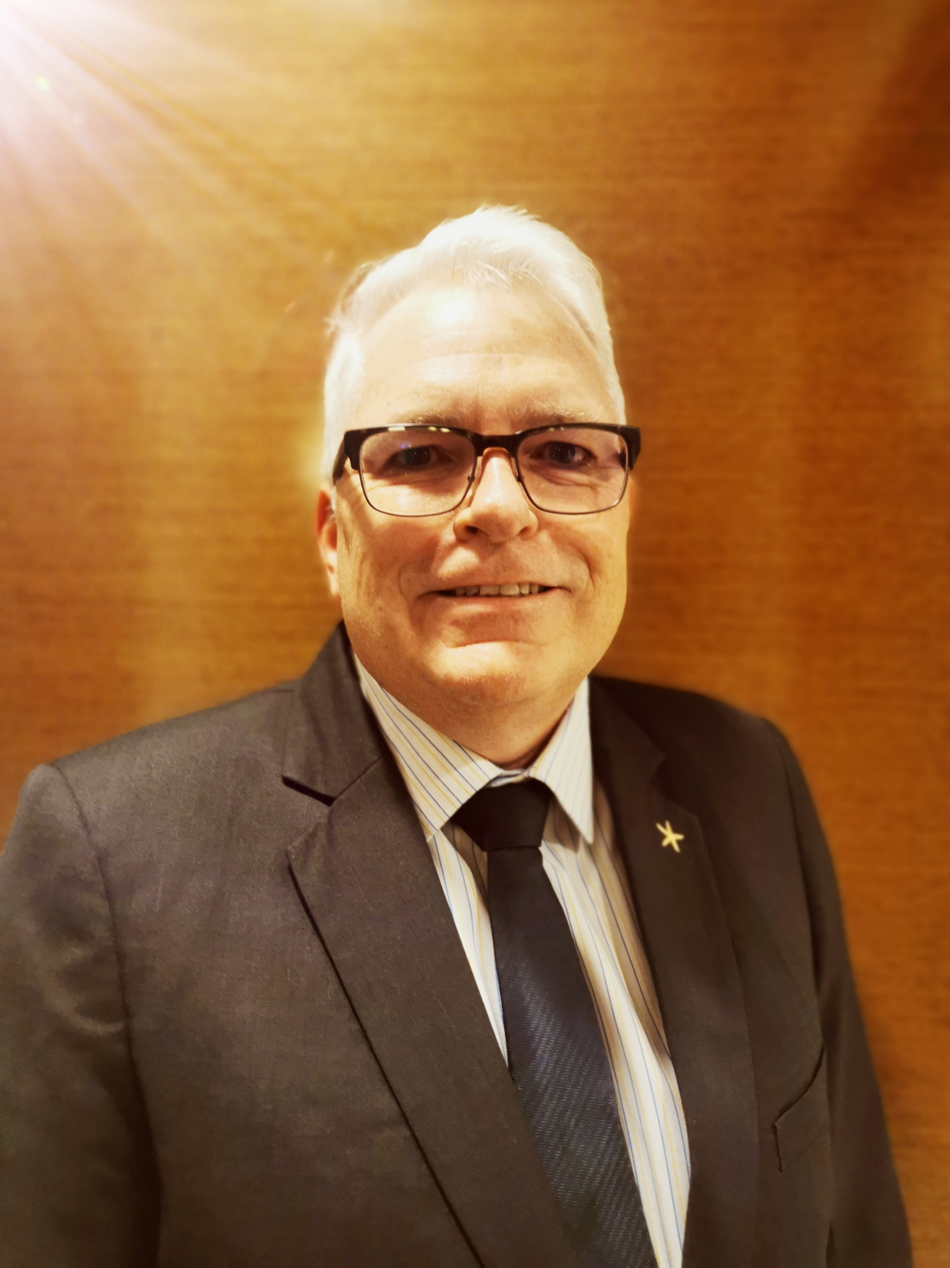
David Thompson Secondary School is situated on the unceded and crossover territories of the Secwépemc and Ktunaxa People and on the land chosen as home by the Metis Peoples of BC.
School data is collected and reviewed from a number of sources each school year. Report cards are reviewed each term and the Student Learning Surveys are conducted each year for grades 10 and 12. School-based surveys are also used to gather feedback from students, parents and staff; along with other measures to collect information.
Literacy is assessed in a variety of ways including the District Wide Write and CAT-4, along with classroom assessments in grades 8 and 9. Students in grades 10 and 12 write the provincial Literacy Assessment.
In 2021-22, DTSS piloted a grade 8 and 9 Numeracy Assessment. This assessment will be written by all grade 8 and 9 students this year and the results will be reviewed with staff in order to improve the numeracy skills of our students. Grade 10 students will write the provincial Numeracy Assessment and the results used to make improvements.
As a staff, we will continuously review data in staff meetings, department head meetings, school-based teams, and grade level meetings. The analysis of this data will inform how we approach planning for improvement.
We look forward to the challenge outlined in our mission statement: to engage and challenge students to think, to care, and to seize opportunities.
Michael S. Hubick

Slide 3
29 Teachers
22 Support Staff
3 Administrators
492
8-12

Slide 4
We collaborate in the pursuit of each student’s success as knowledgeable, caring, resilient, and contributing members of a global community.
Respect We foster respectful relationships that build trust, safety and well-being.
Equity We strive to build learning environments that are equitable, honour diversity and inclusion, are safe, caring and healthy places to work and learn.
Integrity We nurture a sense of self-awareness, responsibility and honesty to become environmental stewards and morally upright global citizens.
Accountability We are accountable for ourselves, our students and our communities for professionalism, transparency and quality results.
Opportunity, equity, and success for ALL learners
Innovation We create learning opportunities that are high quality, place-based, creative, and that encourage students to reach their full potential.

Slide 5
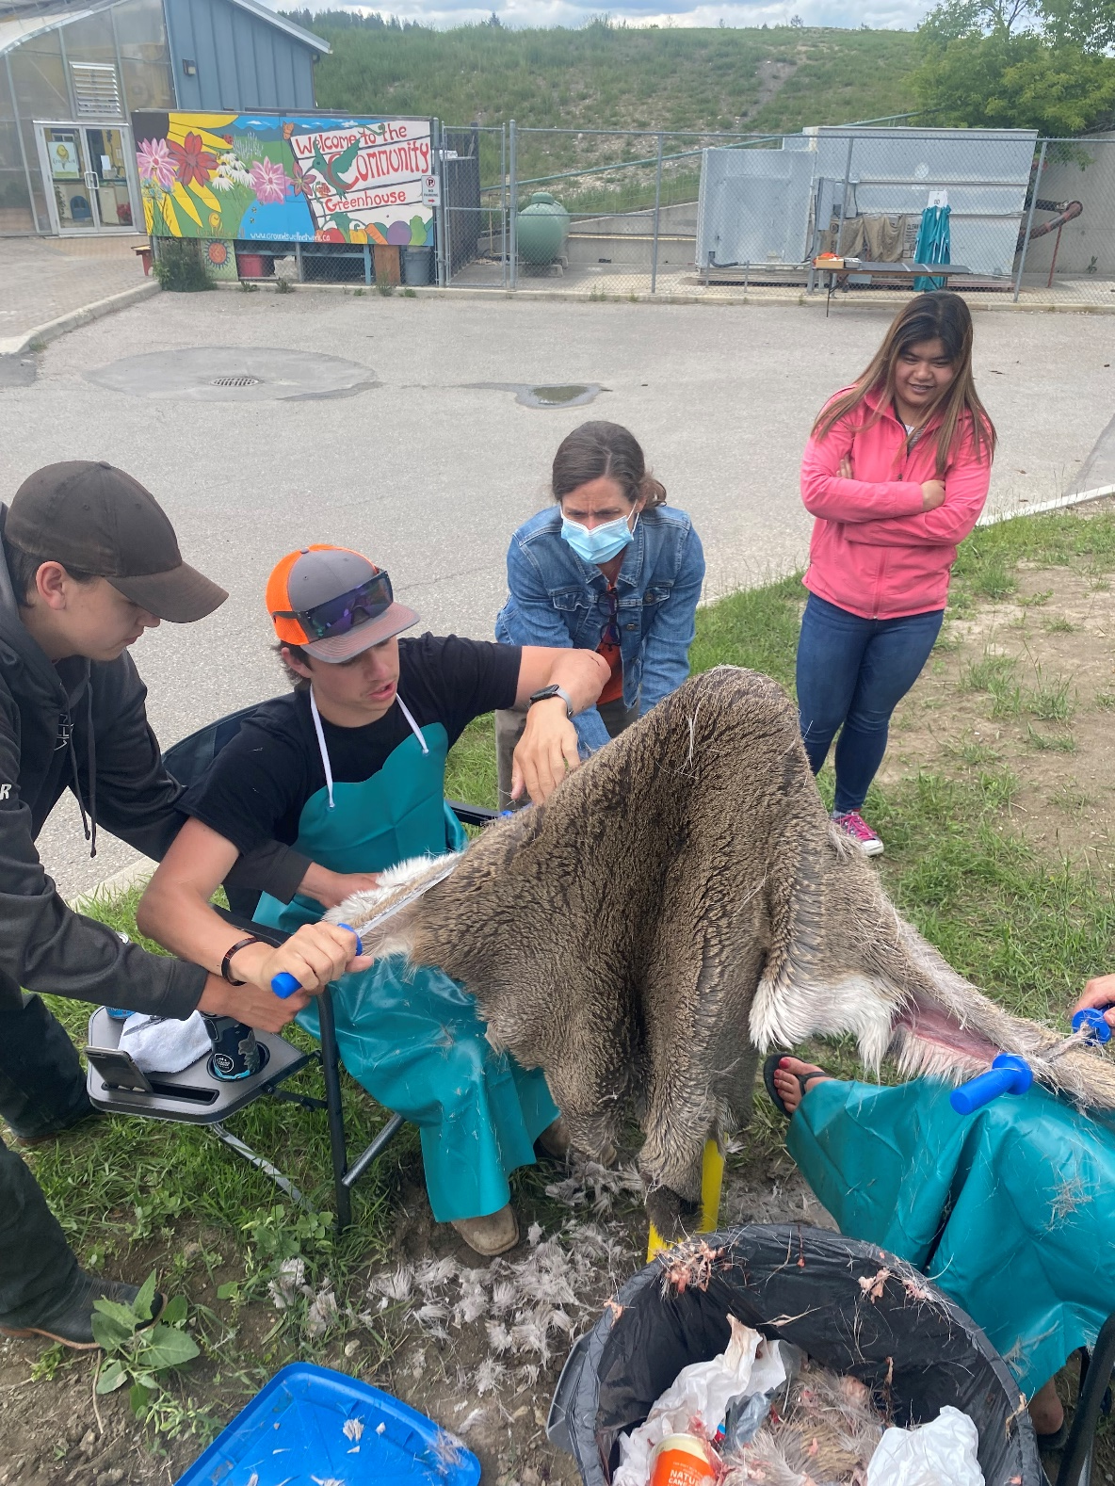
Equity and Inclusion
Increase a sense of connectedness of students at DTSS.
This is in alignment with the First Peoples Principles of Learning, “learning ultimately supports the well being of the self, the family, the community, the land, the spirits, and the ancestors.”
This priority is also supported by the following data:

Slide 6
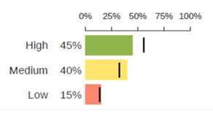
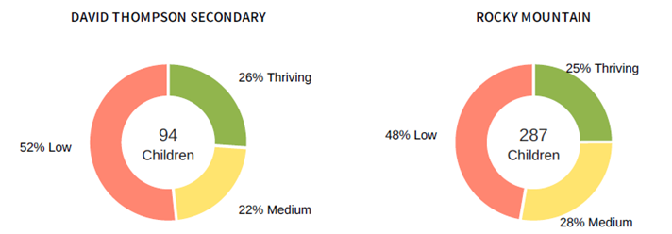
: Grade 8 Middle Years Development Instrument Survey (January 2022)
Connectedness with Adults. Survey item: “At my school there is an adult who believes I will be successful.” Graph 1 compares DTSS with the all grade 8 students in the district. | Well-Being Index measures optimism, happiness, self-esteem, absence of sadness, and general health. Graph 2 compares DTSS with the all grade 8 students in the district. | What this data tells us: Fewer student at DTSS indicate that there is an adult that believes that they will be successful than the comparative data across the district. The Well-Being Index data indicates that a large percentage of DTSS students report as “low” in the domains measured. This presents significant concerns related to overall well-being and resiliency. Making concerted efforts to build opportunities for connections increases the likelihood of improvement in this area.
Graph 1 Graph 2

Slide 7
: Student Learning Survey
 | Is school a place where you feel like you belong? |  | Do you feel welcome at school? |  | Do you feel safe at school?
 | Grade 10 | Grade 12 | Grade 10 | Grade 12 | Grade 10 | Grade 12
Never or Almost Never | 20% | 20% | 14% | 3% | 6% | 3%
Sometimes | 29% | 32% | 30% | 31% | 19% | 13%
Most/All of the Time | 40% | 41% | 50% | 63% | 69% | 82%
Don’t know/No answer | 8% | 6% | 3% | 1% | 3% | 1%
This survey data shows us that we have much to work on in the area of co-creating a school environment that fosters a strong sense of community for every student. Our focus on connections in goal one centers around all students feeling safe, cared for and respected at school.

Slide 8
: Student Learning Survey
 | How many adults do you feel care about you?
 | Grade 10 | Grade 12
None | 10% | 1%
1 Adult | 11% | 0%
2 Adults | 23% | 14%
3 Adults | 13% | 13%
4 or more Adults | 22% | 57%
Don’t know/No answer | 18% | 13%
Many studies around student success in school have concluded that the likelihood of student success is strongly corelated to the strength of relationship they have with adults.
The survey data suggests that there is need for a concerted effort in this area particularly in the case of grade 10 students who responded “none” to the prompt.
The dramatically different results in the grade 12 data gives cause for optimism. Notably, 57% of grade 12 students report to have strong relationships with 4 or more adults.
This may suggest that relationships strengthen significantly over time and further supports the need for intentional strategies early in the students' high school experience.

Slide 9
We asked parents to respond the following:
“We are considering a structure to enhance student mentorship (older students working with younger students), under the guidance of a teacher on some days. Do you think this is a good idea?”
Of the 100 parent responses, 68% told us that they supported the idea.

Slide 10
Student surveys conducted were consistent in identifying student sense of belonging to the school and student mental health as a key areas of focus for staff. This was reinforced when our District Student Advisory Council met with district leadership to share the same conclusion. Parents input at the Community Engagement event in the spring of 2022 agreed. Staff reported the same findings. Parents also identified CORE as an effective tool to build students’ connection and mental health.
Several strategies and programs will be incorporated to build connection and improve mental health of students. Some of these programs include:
Multi-graded Homerooms meeting regularly with students
Peer and Staff Mentorship
Safe Talk
Sharing Circles
Relationship Building
Increasing the visibility and usage of of Secwepmc, Ktunaxa and Michif languages within the school
To what extent will the implementation of staff initiated, weekly check in practice with students improve students’ sense of connectedness?

Slide 11
Formative:
Mini Surveys and Student Focus Groups.
Bi-monthly staff meetings
Summative:
Student Learning Surveys
5% drop in the number of students in the Never/Almost Never, and 5% increase in Most/All of the Time
Grade meetings in September to establish grade profile
Staff meetings at the conclusion of each term (Nov, Feb, May)
Check in strategies
Continued work with Trauma-Informed practices
Spirit Work
Safe Talk Training
Monday CORE (multi-graded homerooms)
School-Based Team
Grade Meetings
Staff Meetings

Slide 12
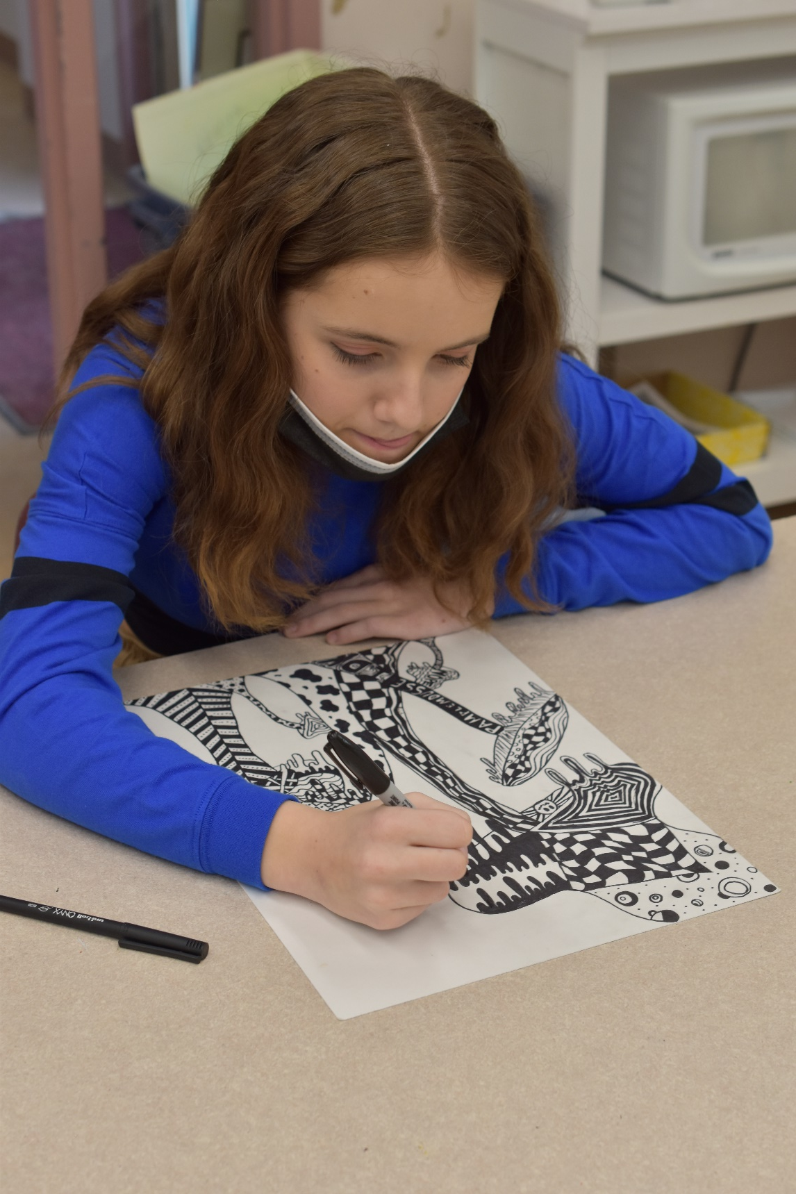
Success for all Learners
Increase students’ critical thinking skills across the curriculum.
This is in alignment with the First Peoples Principles of Learning, “learning is holistic, reflexive, reflective, experiential and relational.”
This priority is also supported by the following data:

Slide 13
: November Provincial Assessments – Numeracy 10
Domain: Critical Thinking
This assessment groups student results in three levels of critical thinking skills. From lowest to highest they are Recall, Skill Concept and Strategic Thinking respectively.
33.57% of DTSS student reached the highest level compared to 41.88% of their district and 37.82% of their provincial peers.
Note: this assessment was conducted with 2 cohorts only. One cohort was studying Foundations of Mathematics and Pre-Calculus while the second was studying Workplace Mathematics. These represent 2 different curricula.

Slide 14
: April Provincial Assessments – Numeracy 10
Domain: Critical Thinking
This assessment groups student results in three levels of critical thinking skills. From lowest to highest they are Recall, Skill Concept and Strategic Thinking respectively.
38.31% of DTSS student reached the highest level compared to 31.91% of their district and 37.99% of their provincial peers.
Note: this assessment was conducted with 3 cohorts only. All three were studying Foundations of Mathematics and Pre-Calculus while none of the cohorts were studying Workplace Mathematics.

Slide 15
: November and April Provincial Assessments – Numeracy 10 Average of Results
Domain: Critical Thinking
This assessment groups student results in three levels of critical thinking skills. From lowest to highest they are Recall, Skill Concept and Strategic Thinking respectively.
35.94% of DTSS student reached the highest level compared to 36.90% of their district and 37.14% of their provincial peers.

Slide 16
: November Provincial Assessments – Literacy 12 Part A
Domain: Critical Thinking About Texts
This assessment assesses students’ abilities to think critically about texts.
56.30% of DTSS student demonstrated ability to think critically about texts compared to 57.07% of their district and 60.60% of their provincial peers.

Slide 17
: November Provincial Assessments – Literacy 12 Part A
Domain: Critical Thinking About Texts
This assessment assesses students’ abilities to think and make inferences beyond what is provided in a written text.
50.71% of DTSS student demonstrated ability to think and make inferences beyond what was provided in the texts compared to 53.57% of their district and 56.82% of their provincial peers.

Slide 18
The provincial Literacy and Numeracy Assessments ask students to interpret information, draw conclusions and critically think about data presented in charts, tables, infographics, blogs, social media feeds, and a diverse array of texts across multiple subject areas.
Our students performed slightly below the provincial average in some of these critical thinking aspects of the assessments.
Students need to work with infographics and other unique displays of data in all of their courses to better apply their critical thinking skills towards information presented in various forms.
To what extent will teachers using infographics to teach students to interpret and analyze data, contribute to increased critical thinking skills for students?

Slide 19
Provincial/School Assessments
Staff meetings: 2 student samples
Core Competency Self-Reflection
Students achieve
5%
higher on
DOK 3/Level 3 sections of the Numeracy and Literacy Assessments
Staff review Report to Schools after each session
Core Competency Self-Reflection in Jan and June
Staff Pro-D – closer look at assessments
Replace CAT 4 with CAT-5 assessment
Staff Meetings
Department Head Meetings
Collaborate with District Principal for Literacy

Slide 20
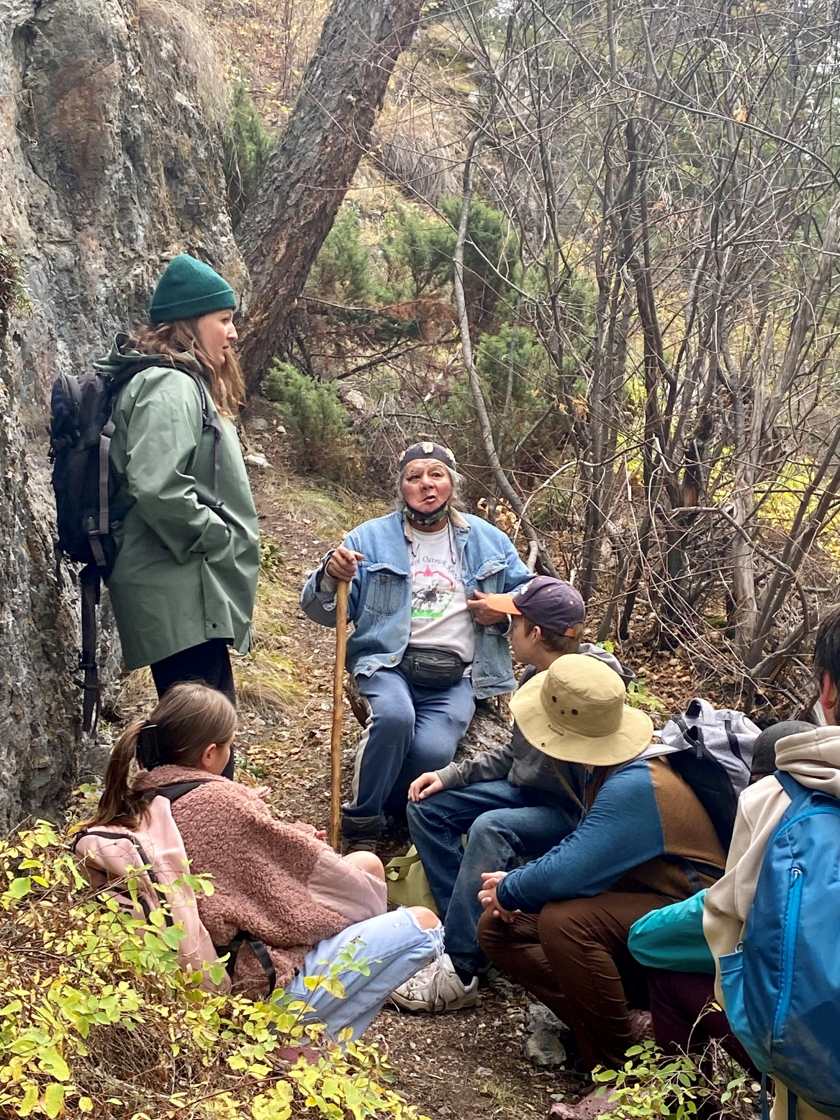
Excellence in Teaching and Leadership
Increase staff knowledge in using Trauma-Informed practices
This is in alignment with the First Peoples Principles of Learning, “learning involves patience and time,” “learning involves generational roles and responsibilities,” and “learning requires exploration of one’s identity.”
This priority is also supported by the following data:

Slide 21
:Grade 10 Student Learning Survey
Domain: Mental Health
Grade 10 students were asked to respond to the following question:
How would you describe your mental health?
Possible responses were: Excellent, Very Good, Good, Fair, Poor and Don’t Know/No Answer.
Note: 54% of student respondents reported in the Poor to Fair categories while 39% reported in the Good to Excellent ranges. (2% did not respond)

Slide 22
:Grade 12 Student Learning Survey
Domain: Mental Health
Grade 12 students were asked to respond to the following question:
How would you describe your mental health?
Possible responses were: Excellent, Very Good, Good, Fair, Poor and Don’t Know/No Answer.
Note: 53% of student respondents reported in the Poor to Fair categories while 38% of students reported in the Good to Excellent ranges. (8% did not respond)

Slide 23
Surveys revealed a majority of our students described their mental health as poor or fair.
District Student Advisory Committee asked for assistance in helping peers cope with stress and instruction on strategies for suicide prevention.
Staff, students and parents requested more mental health resources to assist students.
We need to establish a shared understanding about how to create a welcoming, caring and safe school that fosters positive mental health for students.
Trauma-Informed practices and the UBC’s Teach Mental Health Literacy offer promising learning opportunities for staff to help build their own and their students’ mental health and thus, improve students’ ability to self-regulate.
To what extent will staff report being better able to support student mental health if they participate in structured professional development on Trauma-Informed practices?

Slide 24
3
Times at staff meetings
Staff survey
100%
of staff report more confidence in supporting students’ mental health
August Pro-D
December Staff meeting
February Pro-D
March Staff meeting
UBC Teach Mental Health Literacy
continue Trauma-Informed Schools course
Staff Meetings
Collaborate with District VP for Learning Services

