Slide 1
<School Logo>
Sept. 6, 2022
Marysville Elementary School

Slide 2
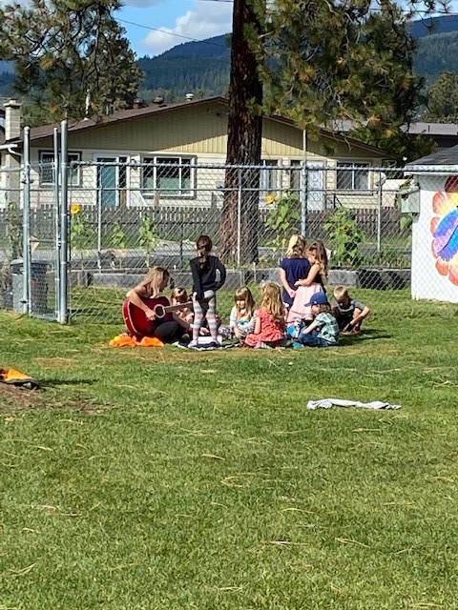
Marysville Elementary School is a K – 3 school with a deep commitment to outdoor, space-based learning, First Peoples Principles of Learning and collaboration.
Our staff are passionate about nature and student-centered, place-based teaching and learning.
Our students are delightful and engaged with their learning and with the adults in the school. We are focused on identity and belonging to increase attachment, self-regulations skills and confidence with learning.
Our parents are supportive and while diverse in their lifestyles and view, they all have a voice at our school. We have been so happy to be able to open our doors and connect with parents face to face recently!
Our community is growing with a new neighborhood being built and housing sales on the rise. We welcome everyone!

Slide 3
8 classroom teachers
1 librarian
1 Learning Services Teacher
3 Education Assistants
1 Administrative Assistant
1 Principal
Part-time Itinerant staff including SLP,
Counsellor, CLINK, YCW
165 students
Kindergarten – 39
Grade 1 – 51
Grade 2 – 37
Grade 3 – 38
Indigenous – 24 plus K
Kindergarten to Grade 3
2 -Kindergarten
2- grade 1
1 -grade 1/2
1 -grade 2
1 -grade 2/3
1 -grade 3

Slide 4
We collaborate in the pursuit of each student’s
success as caring, resilient members of a
global community.
Respect We foster respectful relationships that build trust, safety and well-being.
Equity We strive to build learning environments that are equitable, honour diversity and inclusion, are safe, caring and healthy places to work and learn.
Integrity We nurture a sense of self-awareness, responsibility and truthfulness in ALL students so that they will become environmental stewards and morally upright global citizens.
Accountability We are accountable for ourselves, our students and our communities for professionalism, transparency and quality results.
Innovation We create learning opportunities that are high quality, place-based, creative, and that encourage students to reach their full potential.
Opportunity, equity, and success for ALL learners

Slide 5
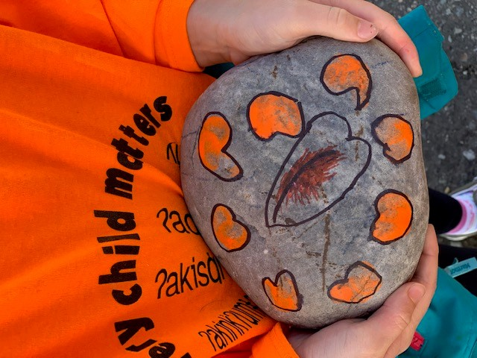
1. Equity and Inclusion
To increase student’s sense of belonging.

Slide 6
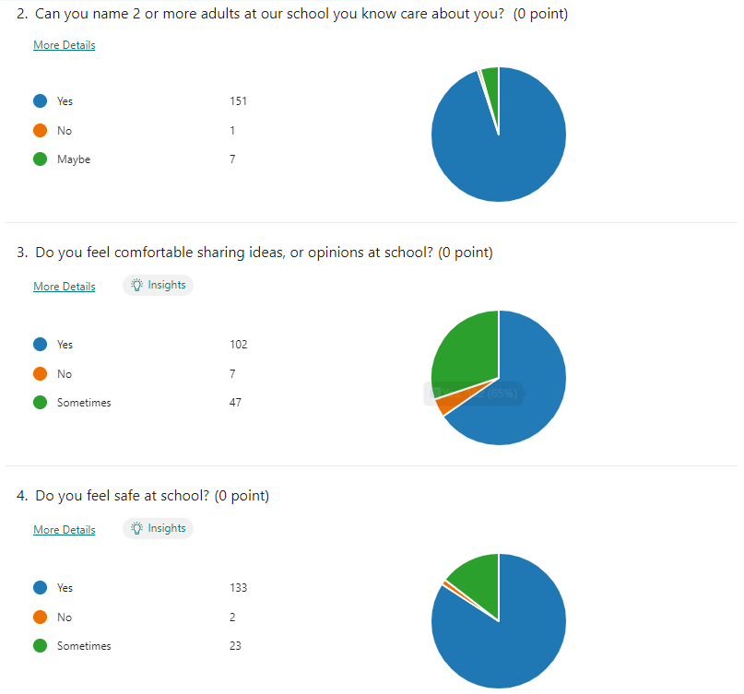

Slide 7
The First Peoples Principles of learning states “Learning requires exploration of one’s identity”, and the fourth OECD principle of learning states, “The learning environment is acutely sensitive to the individual differences among the learners in it,
including their prior knowledge”.
A sense of belonging impacts learning. We would like to increase student understanding of what it means to belong then find ways to track that data through surveys.
We will survey students to establish a base-line understanding and data set of their understanding of what it means to belong. We will focus on developing and recognizing a sense of belonging in our school community.
To what extent will focusing on
naming and nurturing a sense of
belonging increase a
sense of belonging for students?

Slide 8
Establish baseline data in the fall, then 10 % growth in students who feel belonging in our school from fall to spring.
Review belonging survey in August 2022,
all students complete survey in October 2022, January 2023, May 2023.
Student belonging survey spring 2022 baseline and reflect on three times a year. More frequently for students at risk.
Wild school project – year 2 (outdoor learning),
Pro D Days August – Outdoor ed, compassion, trauma-informed practice
Book clubs (optional)
-Monthly staff meeting review
-Collaboration blocks in grade groups
-Parent and community engagement

Slide 9
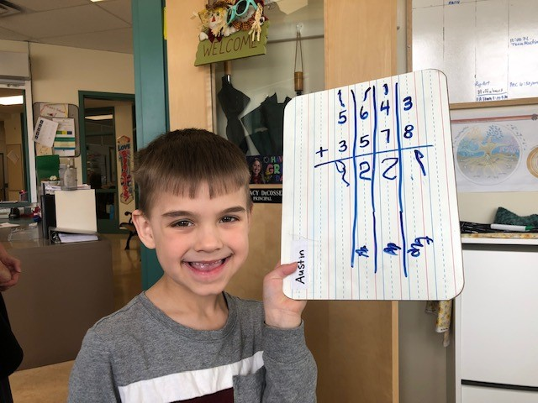
2. Success for all learners
#1: Number Sense
To reduce the number of students who are
emerging in number sense.

Slide 10
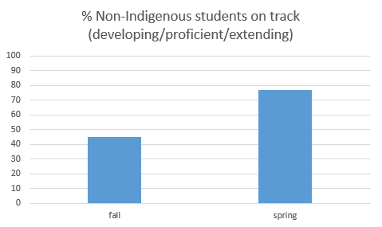
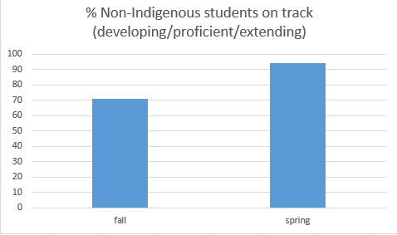
- Fall 2021 - Spring 2022

Slide 11
We are continuing to explore the teaching and assessment uses of the SNAP numeracy assessment. This assessment allows students to show their thinking about numbers, as well as their ability to do computation. The area where students were less successful overall was “reflecting and communicating” their thinking about numbers.
Teachers will focus on learning activities that promote reflecting and communicating thinking in math.
Will a school-wide focus on reflecting and communicating
Thinking section of the SNAP assessment improve student’s ability to reflect on and communicate their thinking about numbers?

Slide 12
10 % growth in students from emerging to on-track (developing, proficient, extending).
Review fall SNAP results October 2022, February and May 2023
Interventions for emerging learners reviewed at School Based Team meetings (every two weeks)
SNAP numeracy assessment fall, winter, spring and review of data at monthly staff meetings
Development of a Primary Numeracy Team,
Focus on proficiencies and developing primary tasks,
Number talks
Collaboration blocks in like grade groups, Instructional rounds,

Slide 13
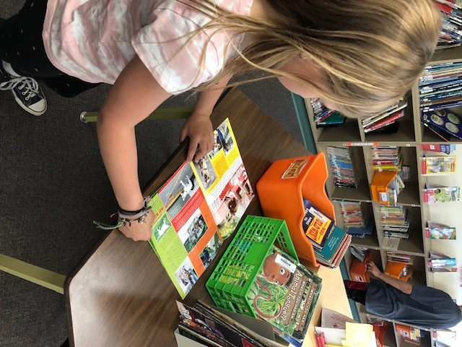
2. Success for all learners
#2: Reading To increase the number of students on-track
(developing/proficient/extending) in reading.

Slide 14
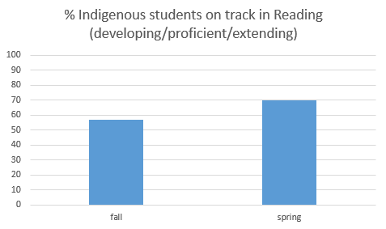
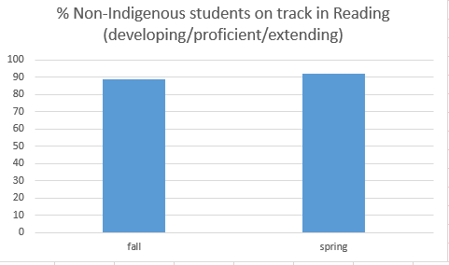
Spring 2022

Slide 15
We are excited about the progress of our students this year, but are looking to adjust our strategies to increase student achievement. We are revising how our EA support schedule works, have purchased book boxes for all students for personalized interventions and plan to specifically track Indigenous students and students who start the year emerging.
All grades will work to improve reading skills such as letter/sound recognition, sight words, and decoding using individual book boxes for targeted interventions.
To what extent will a daily, individual focus on phonemic awareness skills (letter blends and sounds) improve student achievement?

Slide 16
Review data October 2022, February and May 2023
Interventions for emerging learners reviewed monthly at staff meetings and school based team.
PM benchmark reading assessment fall, winter, spring.
report card data
Review of data at each monthly staff meeting
10 % growth in students meeting expectations on PM benchmark reading assessment.
Heggerty Literacy Program,
Science of Reading course,
Shifting the balance book for all staff
Instructional rounds.
Collaboration blocks in like grade groups,

Slide 17
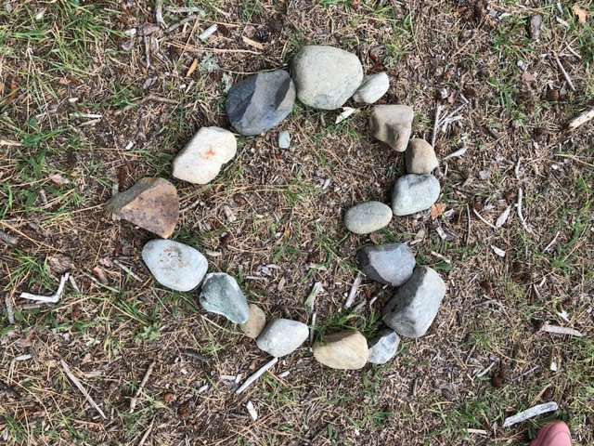
3. Excellence in Teaching and Leadership
Increase opportunities for meaningful professional collaboration for all teachers.

Slide 18
The last two years has reduced our ability to collaborate meaningfully with COVID restrictions. It’s time to refresh our understanding of what quality collaboration means.
Teachers will plan for monthly, scheduled opportunities through collaboration time and instructional rounds to observe, ask curious questions and share strategies and interventions for student learning.
If staff participate in monthly instructional rounds will they report increased confidence in literacy and numeracy instruction?

Slide 19
Fall and Spring staff survey/self reflection on practice and strategies for teaching numeracy/literacy
Monthly staff meeting sharing learning from instructional rounds
80% of staff indicate growth in practice and strategies due to collaboration and observation of peers
Fall and spring surveys
Monthly staff meeting reflection and celebration time
“Instructional rounds in education” book for framework for norms, questions, observations
Instructional rounds
Collaboration blocks in like grade groups,

