Slide 1
September 2022
Alexander Park Elementary School
We have something to howl about at Alexander Park!

Slide 2
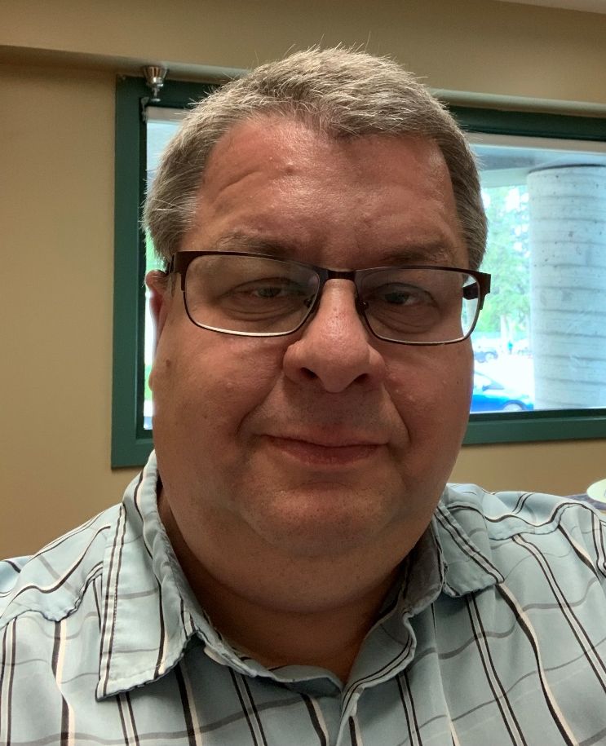
Welcome to Alexander Park, where we discover our world through progressive practices in a caring, respectful environment.
Based on our work towards our 2021-2022 goals, our staff has refined two goals in belonging and literacy, and added a new professional learning goal in mathematics for our 2022-2023 plan for student success.
The professional learning goal from 2021-2022, building our culture of collaboration, is still a priority and embedded within the other goals we have – collaboration will be a key tool we will use to improve student learning and build teaching practices.
And, as always, we continue to grow our school practices towards Reconciliation and recognize the privilege we have to work, learn, and re-learn on the traditional, unceded territories of the Secwepemc and the Ktunaxa Peoples, and the chosen home of the Métis Nation Columbia River community.
Mr. Bob Wilson, Principal Alexander Park Elementary
Our school mascot is a mahihkan (wolf in the Cree language). Wolves are intelligent and adaptable. They not only possess their own strength, but they become stronger through their connections with others in their packs.

Slide 3
26
208
K-3

Slide 4
We collaborate in the pursuit of each student’s success as knowledgeable, caring, resilient, and contributing members of a global community.
Respect
We foster respectful relationships that build trust, safety and well-being.
Equity
We strive to build learning environments that are equitable, honour diversity and inclusion, are safe, caring and healthy places to work and learn.
Integrity
We nurture a sense of self-awareness, responsibility and honesty to become environmental stewards and morally upright global citizens.
Accountability
We are accountable for ourselves, our students and our communities for professionalism, transparency and quality results.
Innovation
We create learning opportunities that are high quality, place-based, creative, and that encourage students to reach their full potential.
Opportunity, equity, and success for ALL learners

Slide 5
Equity and Inclusion
Educators contribute towards truth, reconciliation, and healing. (Standard 9, Teacher Regulation Branch Standards for Educators)
To increase student understanding of what it means to belong.

Slide 6
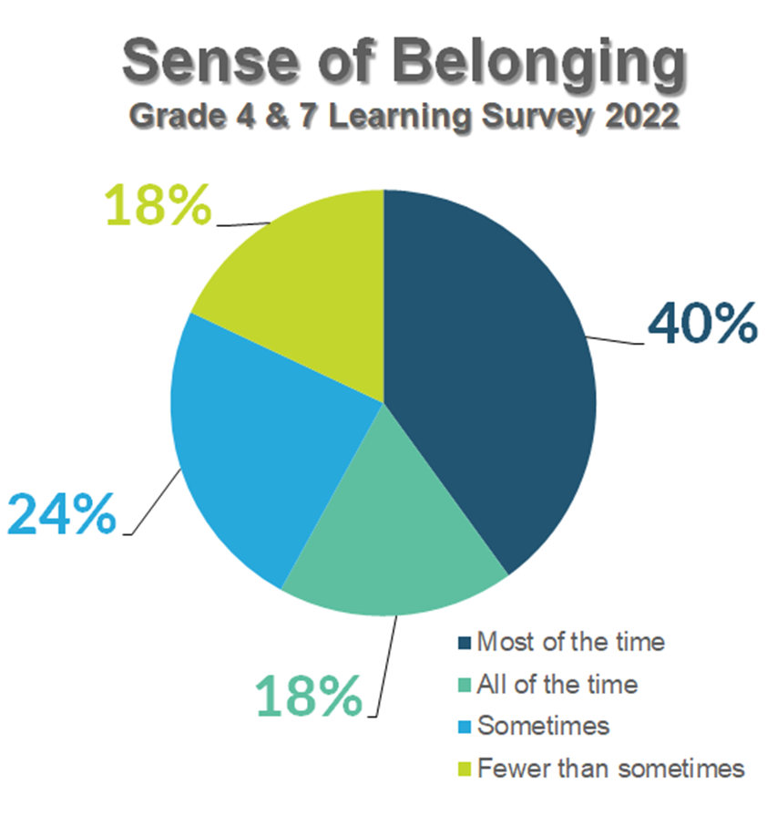
Do you feel you belong at Alexander Park?
88% Yes
5% No
7% Unsure
Do you have friends at school?
96% Yes
<1% No
3% Unsure
Are there grown-ups who care about you at school?
92% Yes
1% No
6% Unsure
Gr. 4 & 7 Lady Grey Information

Slide 7
Student understanding of belonging can be built with regular discussions and reflections about belonging through literature, experiential learning, and personal experiences. Building this understanding will help us determine if our initial evidence is accurate, or if there are areas requiring focus.
Students report feeling a strong sense of belonging at Alexander Park. However, as students age we know that feelings of belonging decrease. This leads us to wonder about the accuracy of our information and whether there was more we could do to support student belonging at (and beyond) Alexander Park.
To what extent will students reflecting monthly on examples of belonging improve their understanding of belonging?
Something to howl about!

Slide 8
In May, 80% of students will show a demonstrative understanding of what belonging means to them.
One exemplar a term (included in progress reports) and monthly collections of exemplars for staff discussions.
Teachers will collect three exemplars during the year, in November, February, and May.
1X per month (staff meeting) teachers will discuss goal and share exemplars of student understanding.
August/ September sessions on trauma-informed teaching practice.

Slide 9
Success for all Learners
Learning involves patience and time. (First Peoples Principles of Learning)
To improve students’ reading achievement.

Slide 10
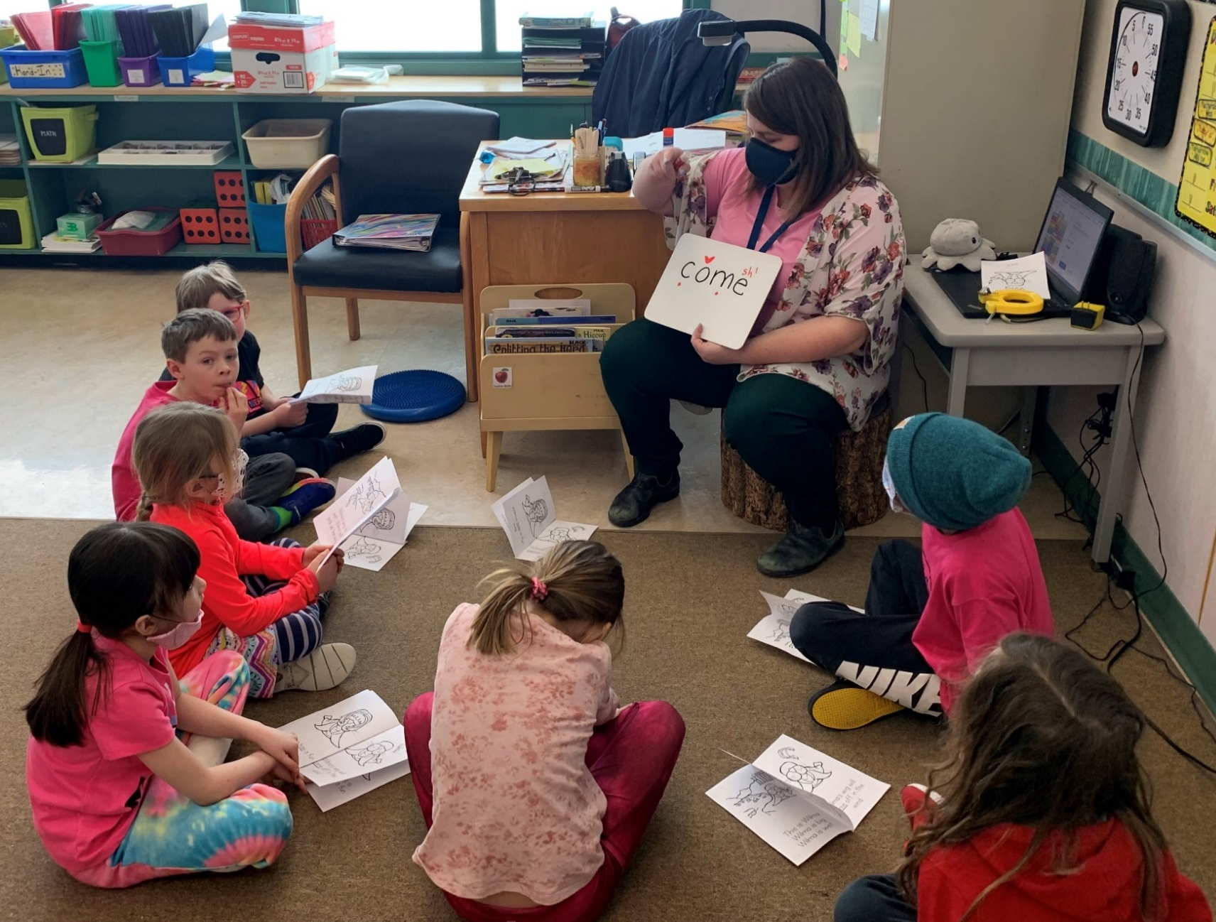
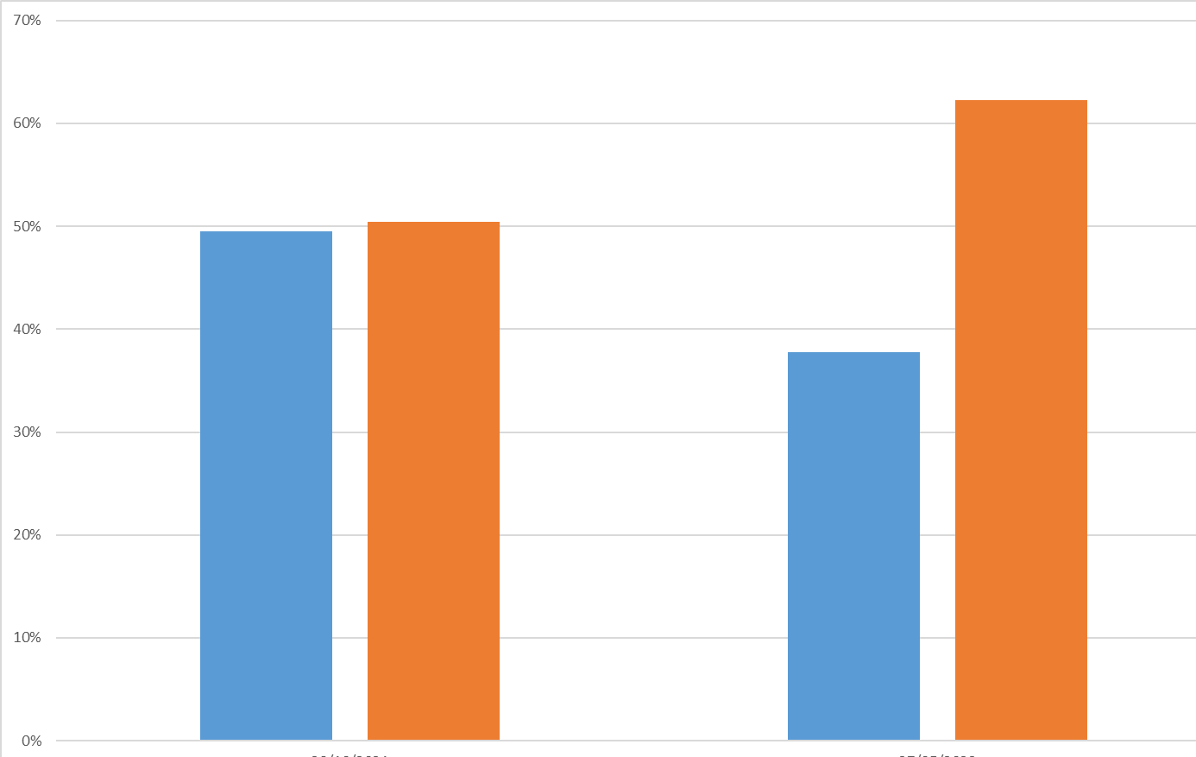
2021/22 Reading Success
PM Benchmarks Current Gr. 2/3 student only
Spring 2022
On Track
Fall 2021
Emerging On Track
Emerging

Slide 11
We have improved this year based on levelled reading assessments, but still have a significantly high proportion of students (35-40%) who are not yet on track in reading development.
Our Learning Services Department reports that the majority of students referred for reading support struggle with grapheme mapping (matching letter to letter sounds) and letter sound knowledge.
K/1 students will receive direct instruction in phonemic awareness and phonics. They will regularly use decodable texts as part of a balanced literacy program.
Gr. 2/3 students will continue to read decodable text, when applicable, as part of a balanced literacy program. They will receive direct instruction of phonics using a phoneme-based spelling program.
Will consistent, school-wide instruction in language sound-based reading improve reading performance?
Something to howl about!

Slide 12
Teachers will choose two students to watch this year, and reflect monthly on their learning to read experiences with other staff members.
PM at least 2X/year
In May 2023, 70% of students will demonstrate proficiency in reading grade level text.
Assessments in October and May, with an interim in January for emerging readers to check progress and plan interventions.
Book Study: Shifting the Balance by Burkins and Yates
1X per month at staff meetings
Learning Rounds
School-Based Team

Slide 13
Success for all Learners
Learning is holistic, reflexive, reflective, experiential, and relational. (First Peoples Principles of Learning)
To improve students’ mathematics achievement.

Slide 14
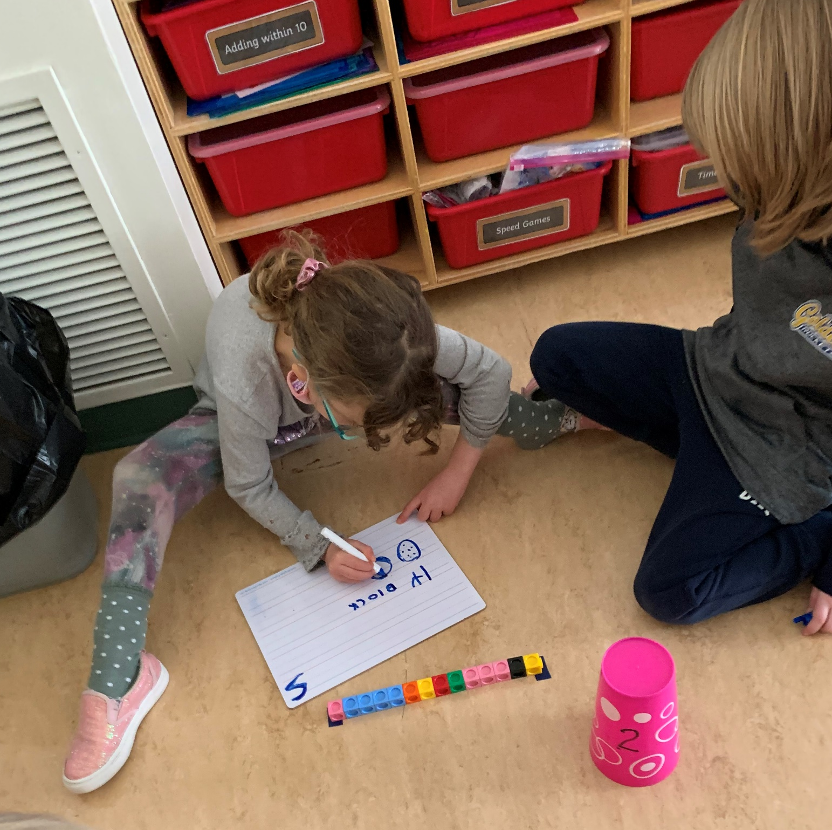
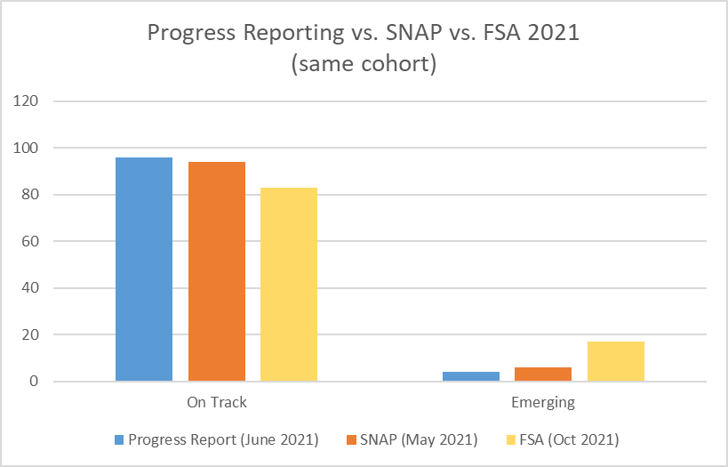

Slide 15
Consistently, our progress reporting data and proficiency on the Student Numeracy Assessment and Practice (SNAP) indicate that students at Alexander Park have an overall strong knowledge of basic mathematics skills and number sense. The Grade 4 Foundation Skills Assessment in numeracy results do not align with our school-based measures.
11% difference between FSA and SNAP in 2021
13% difference between FSA and progress reporting in 2021
How will greater practice with math tasks nested in authentic situations improve student achievement in concepts beyond mathematical skills and number sense?
Students require experience with problems nested within real-world scenarios.
Something to howl about!

Slide 16
Teachers will choose two students to watch this year, and reflect monthly on their mathematical experiences with other staff members.
SNAP 2X/year.
FSA October 2022
December/ March/June staff meetings (time to reflect on target).
Teachers will try at least one math task a month.
August/ September PD
Inviting VP Numeracy for support
Learning Rounds
1X per month staff meeting discussion.
Learning Rounds

Slide 17
Excellence in Teaching and Leadership
Learning is holistic, reflexive, reflective, experiential, and relational. (First Peoples Principles of Learning)
To improve staff collaboration.

Slide 18
Teaching can be an isolating profession. We know the
value of learner focused dialogue and the benefits that
come from sharing practices in a non judgmental
environment. Due to COVID 19 protocol limitations on
collaborative opportunities, we want to refocus attention
on collaborative practices
To what extent will regular learning rounds increase the quality of teacher
collaboration?
Opportunities for teachers to learn from each other.
Something to howl about!

Slide 19
Teachers will be able to see their progress within the rubric, with all teachers evaluating themselves at Level 3.
Monthly check ins with staff who have done learning rounds at staff meetings.
Release time provided regularly (shared within Golden Zone)
1X per month staff meeting discussion.
Monthly staff meetings reflecting on rubric “Teachers Improve Their Practices in the Company of Peers” (particularly the 3rd competency on p. 12 of the document linked below)
Professional learning will be embedded within the Learning Rounds.
Reference: What did you do in school today? Teaching Effectiveness: A Framework and Rubric (edcan.ca)

